Slide 1
AFRICA’s COVID-19 RESPONSE
Professor Isaac F. Adewole, FAS, FRCOG, FNAMed, Dsc(Hons)
Dept of Obstetrics/Gynaecology
College of Medicine
University College Hospital
University of Ibadan
Ibadan, Nigeria

Slide 2
Disclosure
Minister of Health, Nigeria - 2015-2019
Senior Health Consultant-ACDC - January 2022 till date

Slide 3
Acknowledgements
Prof Rob Murphy
CGH-NUC
Dr John Nkengasong-Director ACDC
Dr Raj Taju &SLL Initiatives

Slide 4
Greetings from my base – The University of Ibadan and University College Hospital, Ibadan, Nigeria

Slide 5
Outline
Africa/Epidemiology
The Pathogen/Disease
Clinicals/Susceptibility/Prognosis
Control/Clinical Management
Anti-COVID-19 Drug Trials
Vaccines and Vaccination in Africa
Challenges in Africa
Conclusion

Slide 6
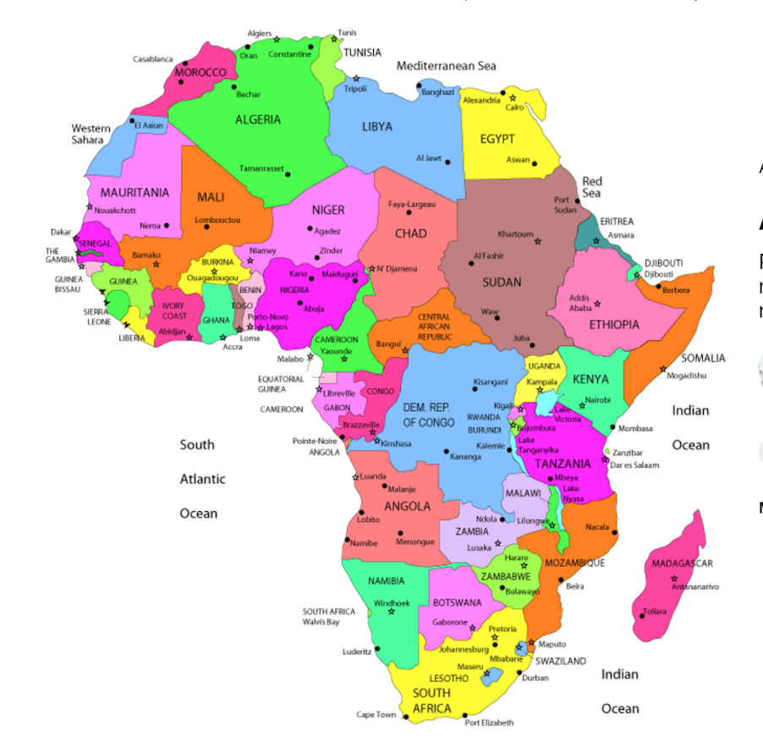
AFRICA
As of 2019, the total population of Africa is estimated at 1.3 billion, representing 16 percent of the world's population. According to UN estimates, the population of Africa may reach 2.49 billion by 2050 (about 26% of the world's total) and 4.28 billion by 2100 (about 39% of the world's total).
41% of Population under 15 years
Life Expectancy - 52 years

Slide 7
Africa 2022
Most Populous Countries
Least Populous Countries
Saint Helena, Ascension and Tristan da Cunha (UK) (non-sovereign): 6,101
Seychelles: 99,426
São Tomé and Príncipe: 227,679
Mayote(France): 286,259
Cape Verde: 567,678
Nigeria: 216,746,934
Ethiopia: 120,812,698
Egypt: 106,156,692
DR of Congo: 95,240,792
South Africa: 60,756,135
Reference : World Population Prospects (2019 Revision) - United Nations population estimates and projections.

Slide 8
COVID-19……
The COVID-19 poses one of the greatest threats in human history as the virus causing the disease has spread rapidly worldwide, affecting the lives and livelihoods of billions of people.
Since the first case was reported in Africa on 15 February 2020, the rise in the number of cases has been exponential. Although most of the initial COVID-19 cases recorded were among travellers returning from COVID-19 reporting-countries to our countries, community transmission is now widespread.
The ability to effectively respond to public health emergencies such as this is strongly influenced by the state of our healthcare system and the extent to which such emergencies have been assessed in advance and prepared for with corresponding prevention and mitigation measures.

Slide 9
COVID-19 and AFRICA
In 2020, the COVID-19 crisis plunged Africa into an exceptional economic recession. Lockdown measures to contain the spread of the virus, combined with the slowdown in activity in its main trading partners and the drop in commodity prices, had a significant impact on the continent's growth:
Africa’s GDP declined by 1.5%, the sharpest decrease in more than 25 years. The impacts of the pandemic on Africa’s private sector were severe. Compared to the rest of the world, support programmes to protect the sector from the harmful conse- quences of the lockdown have been weak in Africa.
…The African private sector in the COVID-19 crisis ….July2021

Slide 10
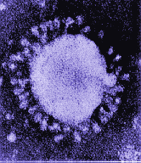
What are Coronaviruses
Family: Coronaviridae
Medium sized RNA viruses
First identified in 1965
Name derived from outer envelope with distinctive, 'club-shaped’ spikes
Looks like a crown or Halo “ Corona”
Notes:
family of viruses first identified in 1965 from respiratory tract of adult suffering from the common cold
Single stranded, positive sense, RNA viruses with a helical symmetry
Medium sized About 60nm -220nm in diameter
MW of about 6x10⁶ D
incased in a membranous envelope

Slide 11
What is SARS-CoV-2
A novel coronavirus which has not previously been present in human populations.
A betacorona virus
Similar to other corona viruses in bats.
Exact origin not yet known
SARS-COV-2 -Severe acute respiratory syndrome coronavirus 2 ( previously known as “2019 novel coronavirus)
COVID-19 –coronavirus disease
Notes:
Zhu et al. A Novel Coronavirus from Patients with Pneumonia in China, 2019 NEMJ DOI: 10.1056/NEJMoa2001017
confirmed by electron microscopy and genome sequencing to be a coronavirus.

Slide 12
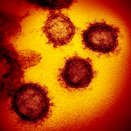
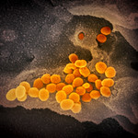
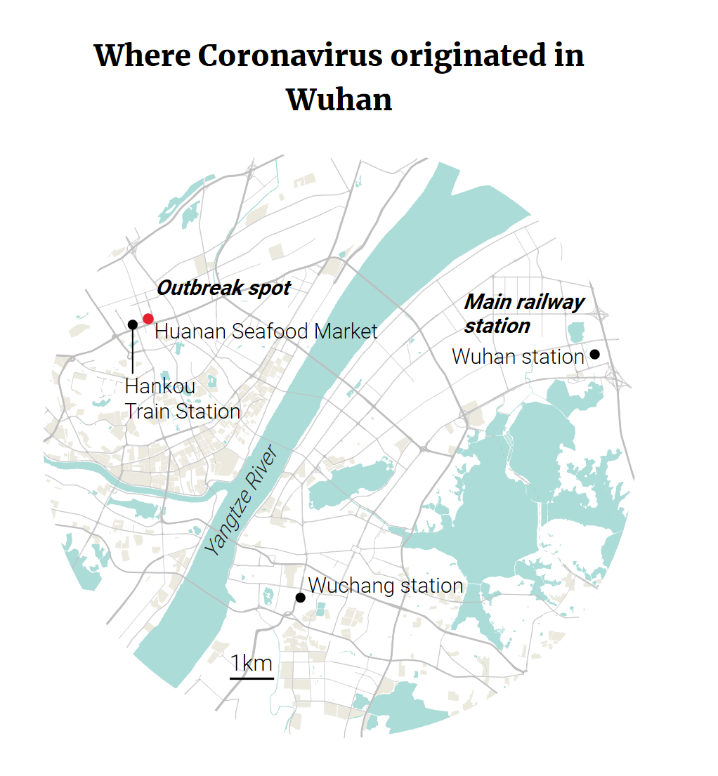
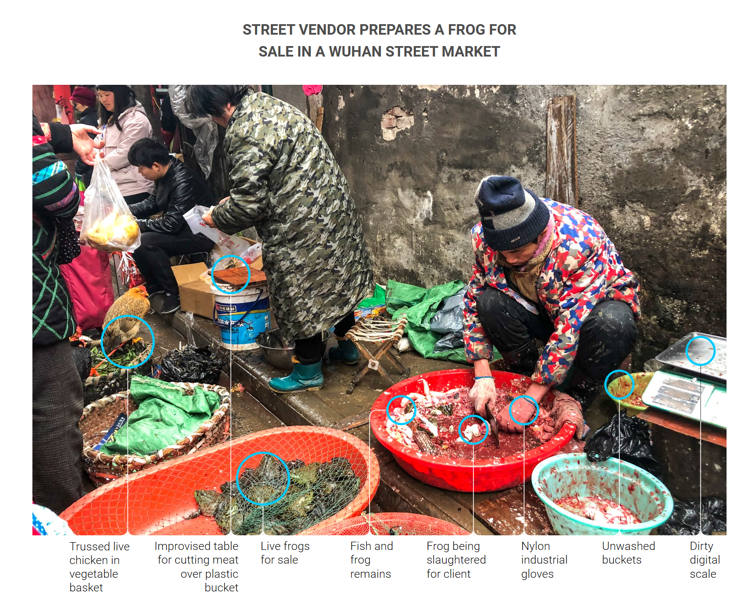
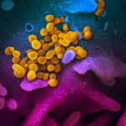
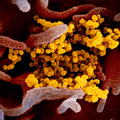
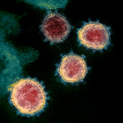
The Origin of the outbreak – Wuhan City

Slide 13

Transmission
Droplets
Human to human transfer occurs from Inhalation of droplets expelled from infected persons respiratory tract through coughing, sneezing
Contact with patient respiratory secretions
Via hands to mucosa through contact with surfaces contaminated with patient respiratory secretions
About 45% of infection from asymptomatic carriers
Hands contaminated with droplets and transferred to face

Slide 14
Global & Regional Timeline till Aug 2020

Slide 15
Timeline of events
China alerts WHO to 44 cases of pneumonia with unknown etiology
China announces first death
Wuhan placed under quarantine
12,102,328 confirmed cases in 213 countries
China rules out SARS
WHO reports first case outside China; Thailand
551,046 deaths
31 Dec
1 Jan
5 Jan
7 Jan
11 Jan
12 Jan
13 Jan
20 Jan
23 Jan
28 Jan
11 July
282 confirmed cases in 4 countries
4593 confirmed cases in 14 countries;
106 deaths
New virus identified as novel coronavirus 2019
Wuhan seafood market shutdown
Genetic sequences shared; development of diagnostics

Slide 16
Clinical signs and symptoms
# Malaria or Flu
Fever
Dry cough
Early/mild disease
pneomonia
Fever >38ºC and headache
Kidney failure
Sneezing/Dry cough, Catarrh, general malaise, sore throat, headache, fatigue, shortness of breath, Diarrhoea, nausea & vomiting, loss of sense of smell and taste
diarrhoea
Severe acute respiratory syndrome/ pneumonia / Bronchitis /kidney failure/Death
Severe disease may require hospitalization

Slide 17
Affected Populations
Human Population
All age groups
Pregnant Population
Children not exempted
Health Workers
Crowds-Market, Churches, Mosques, Rallies,

Slide 18
Physiological Susceptibility to COVID-19
In addition, pulmonary volumes are altered due to diaphragmatic splinting by the gravid uterus, resulting in reduced total lung capacity at term and an inability to clear pulmonary secretions effectively.
Pertinent, as COVID-19 pneumonia rapidly progresses from focal to diffuse bilateral consolidation of lung parenchyma
Which would readily predispose to hypoxemic respiratory failure in pregnancy.
Compared to men, women at reproductive age
are less likely to die
are less likely to require hospital admission
have a 60% lower likelihood of intensive care admission
Notes:
functional residual capacity, end-expiratory volumes, and residual volumes decrease steadily from early pregnancy due to diaphragmatic splinting

Slide 19
COVID-19 Among Pregnant vs Nonpregnant Women
Increased rates of hospitalization, ICU care, and mechanical ventilation, but no increase in symptomatic disease or mortality
  Indication for hospitalization not recorded (may have tested positive during hospitalization for labor and delivery)
Outcome, n (%) | Pregnant (n = 8207) | Nonpregnant (n = 83,205) | Crude Risk Ratio (95% CI) | Adjusted Risk Ratio* (95% CI)
Hospitalization† | 2587 (31.5) | 4840 (5.8) | 5.4 (5.2-5.7) | 5.4 (5.1-5.6)
ICU admission‡ | 120 (1.5) | 757 (0.9) | 1.6 (1.3-1.9) | 1.5 (1.2-1.8)
Mechanical ventilation§ | 42 (0.5) | 225 (0.3) | 1.9 (1.4-2.6) | 1.7 (1.2-2.4)
Death^{ǁ} | 16 (0.2) | 208 (0.2) | 0.8 (0.5-1.3) | 0.9 (0.5-1.5)
*Adjusted for age as continuous variable, yes/no for presence of underlying conditions, categorical race/ethnicity variable; nonpregnant women are the reference group. †Missing information for 1539 (18%) pregnant women and 9744 (12%) nonpregnant women, who were assumed to have not been hospitalized. ‡Missing information for 6079 (74%) pregnant women and 58,888 (71%) nonpregnant women, who were assumed to have not been admitted to ICU. §Missing information for 6351 (77%) pregnant women and 63,893 (77%) nonpregnant women, who were assumed to have not required mechanical ventilation. ^{ǁ}Missing information for 3819 (47%) pregnant women and 17,420 (21%) nonpregnant women, who were assumed to have survived.
Ellington. MMWR. 2020;69:769.
Slide credit: clinicaloptions.com

Slide 20
Prognosis
Risk factors for severe disease:
  Older age > 60
  Coronary artery disease
  Diabetes
  Hypertension
  Chronic pulmonary disease
  Cancer
BUT unfortunately young, healthy patients can get severe disease
Different strains of COVID-19– some more virulent (Wuhan original)

Slide 21

Survival
80% will have a mild illness
Look after yourself:
  Wear PPE and meticulous donning & doffing
Beware / expect:
  Overwhelmed
  Burnout / exhaustion
  Anxiety
  Stress
  PTSD
Peer support
Time out
Notes:
Despite what it says on mums.net, going outside with wet hair is not a risk
Go outside 5 minutes. Dance in the rain.

Slide 22
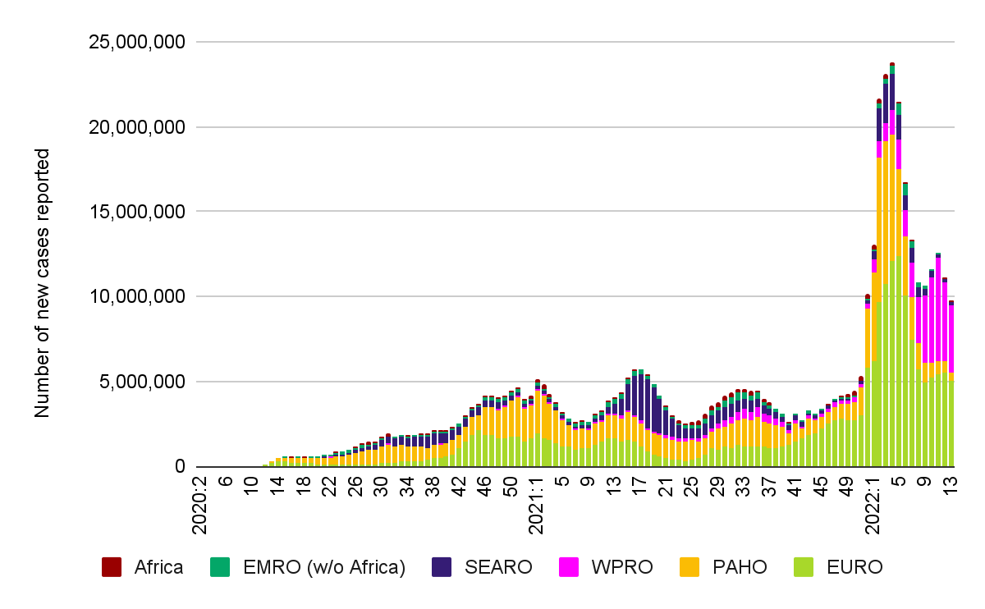
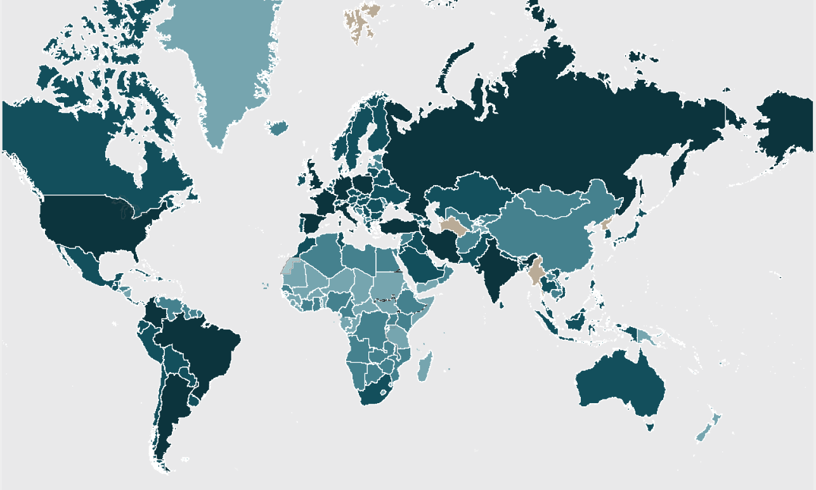
Global COVID-19 Situation
as of 6:14 am CEST 6 April 2022
New COVID-19 cases reported weekly by WHO region, 9 Jan 2020 - 3 April 2022
Key: Country, area, or territory reporting COVID-19 cases
>1M
10K-100K
1-100
100K-1M
100-10K
No Data
492M | 6.2M | 1.3%
*Global numbers are taken from the latest WHO sitrep and dashboard: https://www.who.int/emergencies/diseases/novel-coronavirus-2019/situation-reports; https://covid19.who.int/
confirmed cases
deaths
CFR
Notes:
Starting with the global situation, the chart on the left side of this slide is showing the number of new COVID-19 cases reported by the 6 WHO regions. The number of new cases reported increased in the past week, with more than 9 million new cases reported globally. This is a 12% decrease in the number of new cases reported compared to the previous week. The majority of new cases are being reported from the European and Western Pacific regions. Specifically in the European Region, an increase in cases was observed in epi weeks 9 - 12, with the highest number of new cases being reported from Germany, France and Italy. According to the ECDC, this surge was likely due to the loosening of PHSMs and the presence of the Omicron BA.2
As of yesterday, over 492 million new cases and 6.2 million deaths have been reported globally with case fatality rate 1.3%.
.

Slide 23
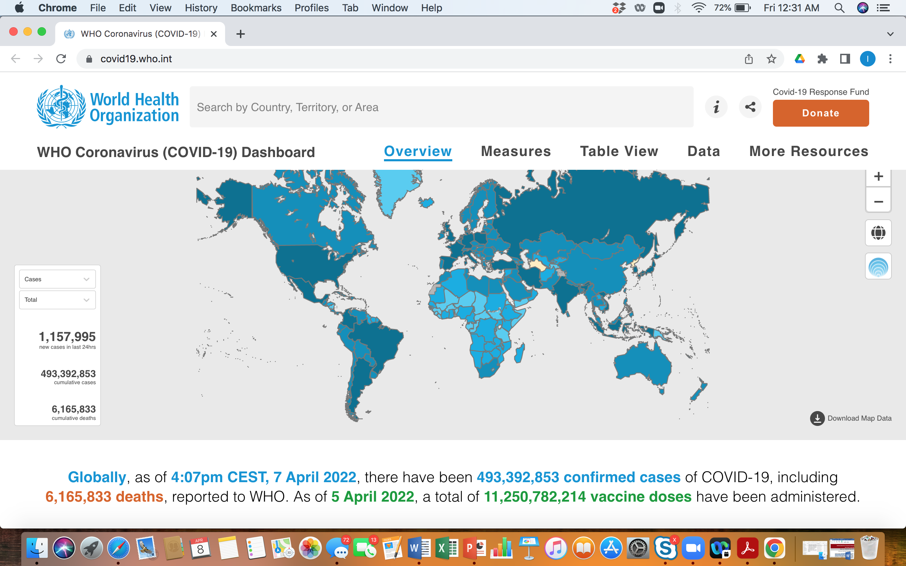

Slide 24
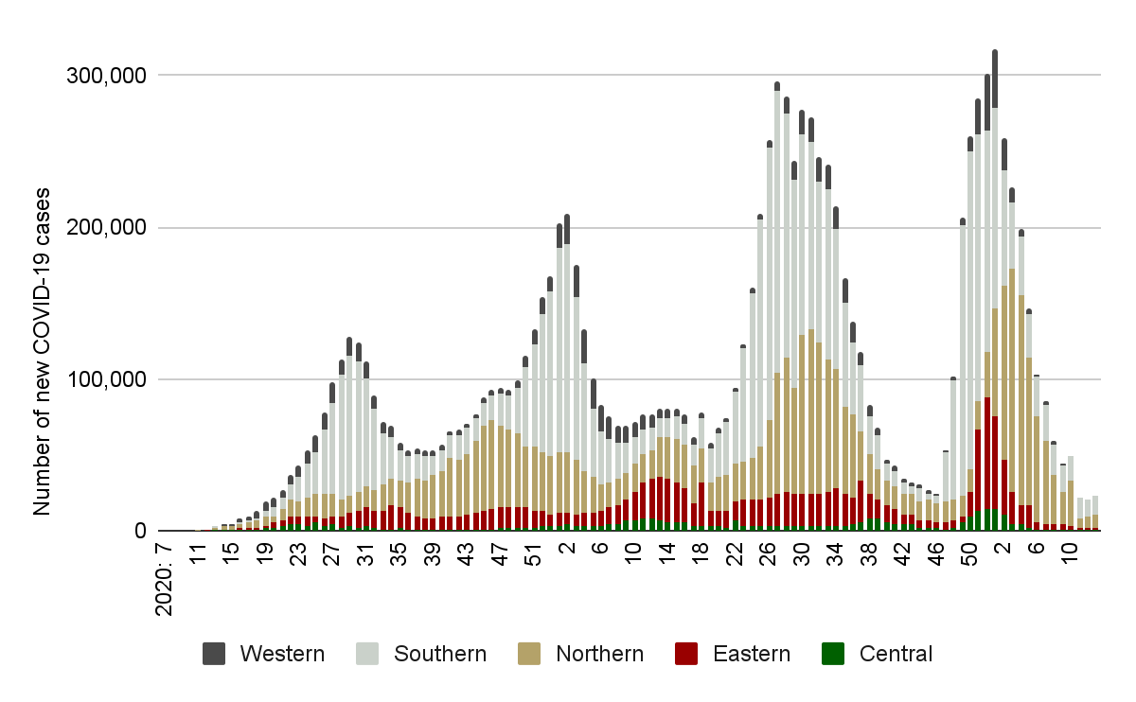
COVID-19 Situation in Africa
as of 6 April 2022, 6 pm EAT
New COVID-19 cases* reported by week and AU Region,
15 Feb 2020 – 3 April 2022
1
2
1
2
1
4
1
3
1
Countries with COVID-19 cases
>1M
>500k - 1M
>100k - 500k
1 - 100k
51
11.4M | 251k | 2.2% | 10.7M
*Africa numbers are taken from official RCC and Member State reports.
cases
deaths
CFR
recoveries
Notes:
Looking at the continental situation, the map on the left shows the cumulative cases being reported from each Member State. The majority (67%) of MS are reporting between 1 - 100 thousand cases as shown in the light pink color. The chart on the right side shows the number of new cases being reported by epi week, and over the past week we observed a 10% increase in the number of new cases reported compared to the previous week. As of 6pm yesterday, more than 11.4 million cases have been reported, with more than 251 thousand deaths resulting in a CFR of 2.2%. Of the cases reported, 94% have recovered.

Slide 25
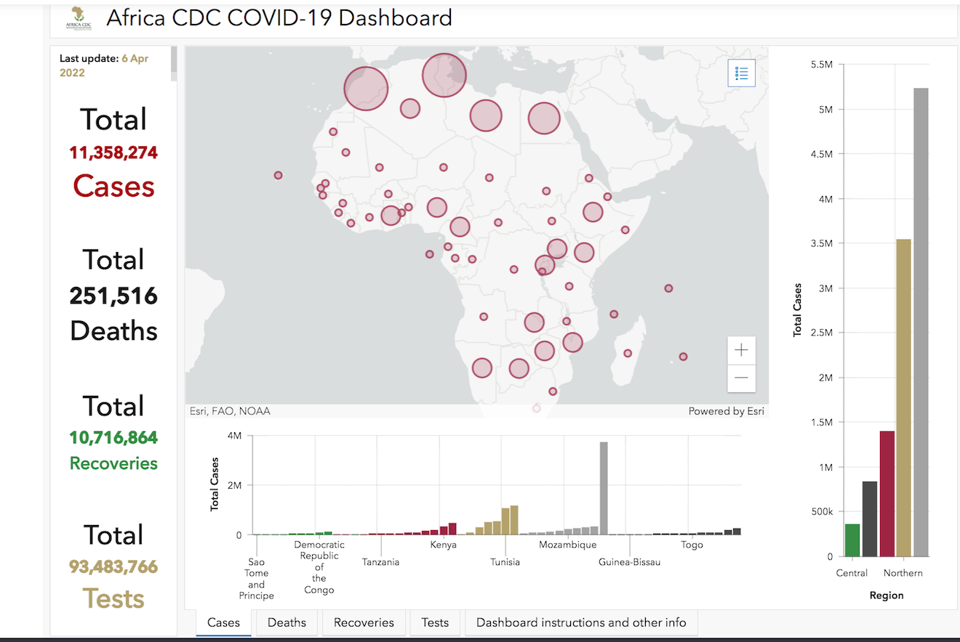

Slide 26
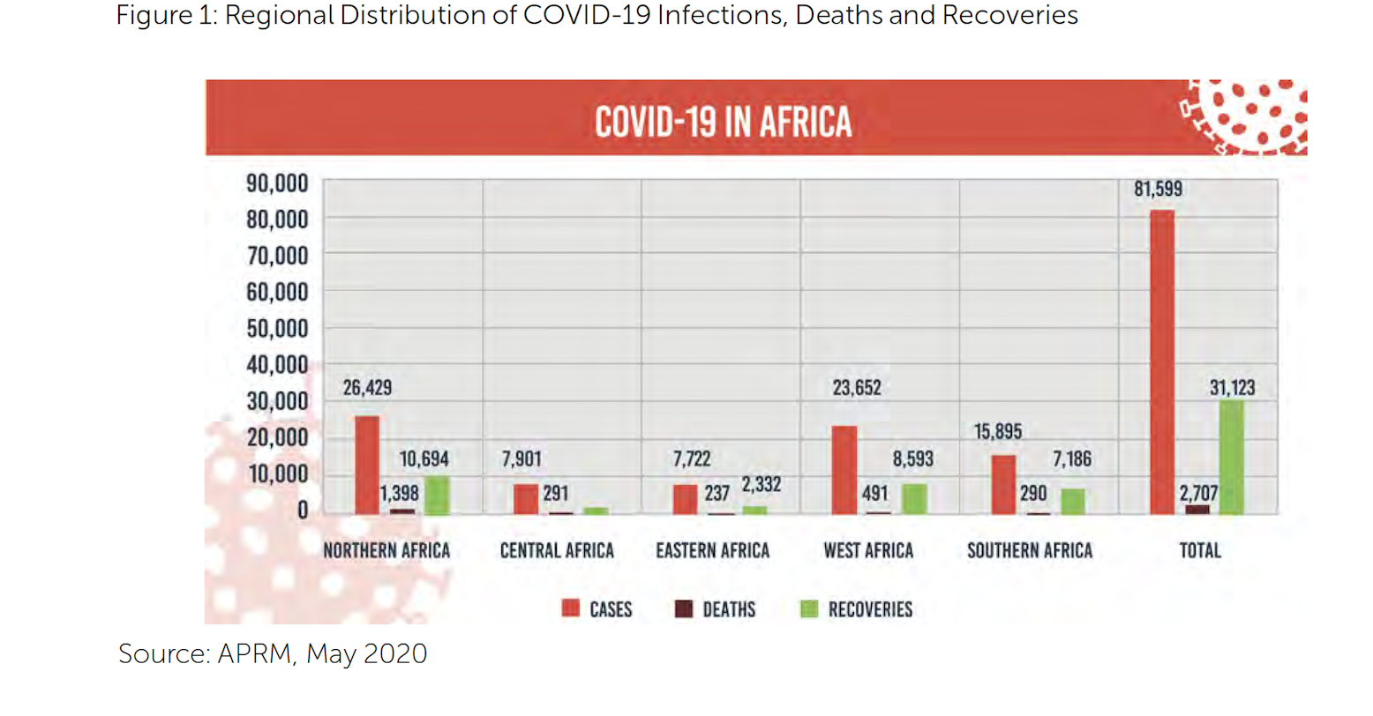

Slide 27
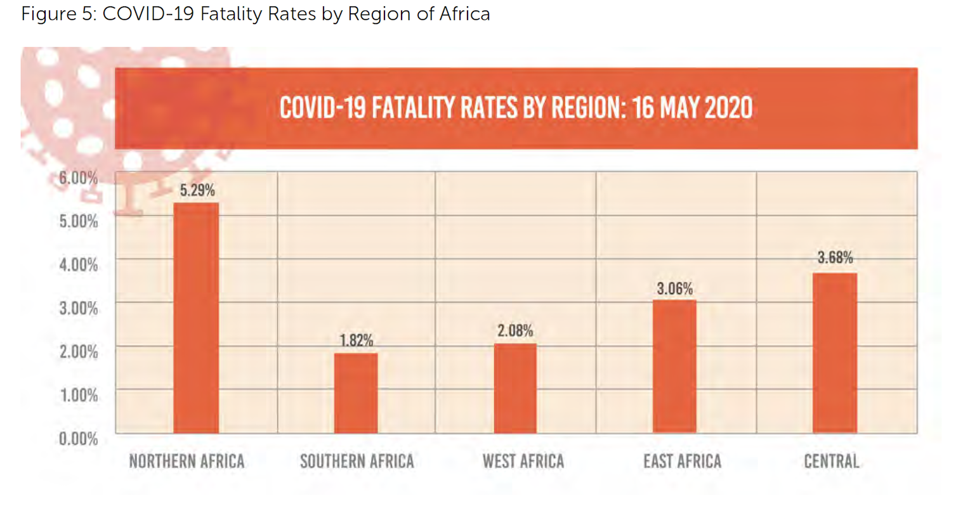

Slide 28
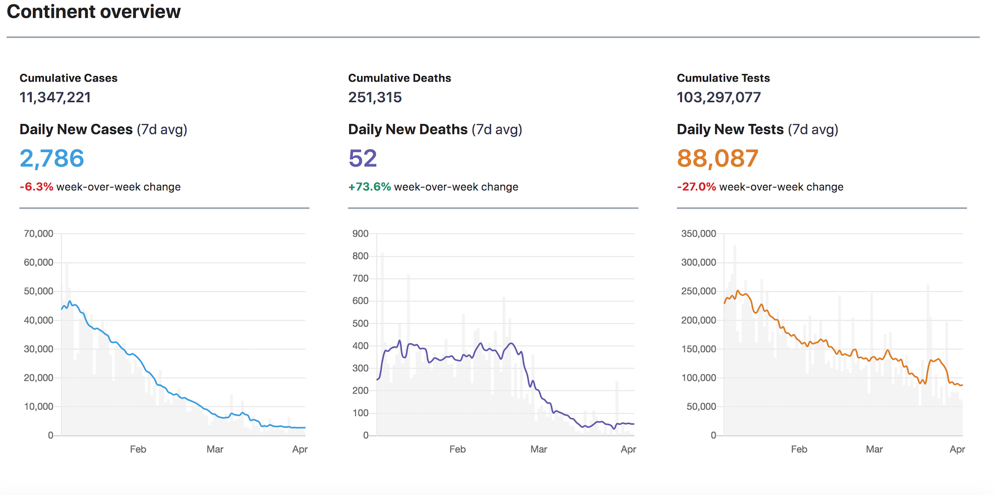

Slide 29
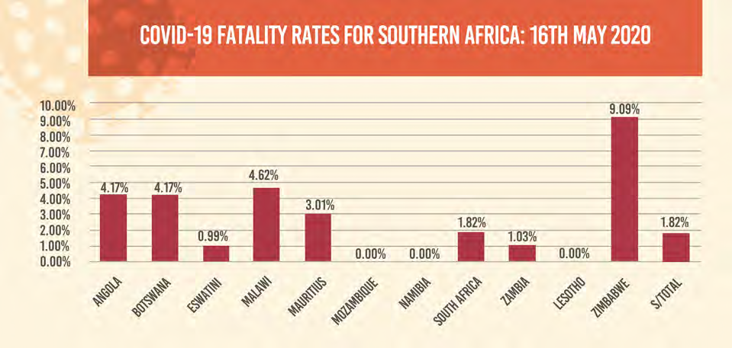
Source: APRM, May 2020

Slide 30
Vaccine for SARS-Cov2
Virus-like proteins
Inactivated Virus
Live attenuated virus
Replicating vector
No replicating vectors
mRNA/RNA
Protein subunit

Slide 31
Emergency Authorization
UK, Europe, Canada, USA, Russia India etc
2 doses required
Booster Approved
5-15 years Approved
Logistic challenge huge
Anti-vaccine lobby strong
Cost
Uncertainty as to duration of protection

Slide 32
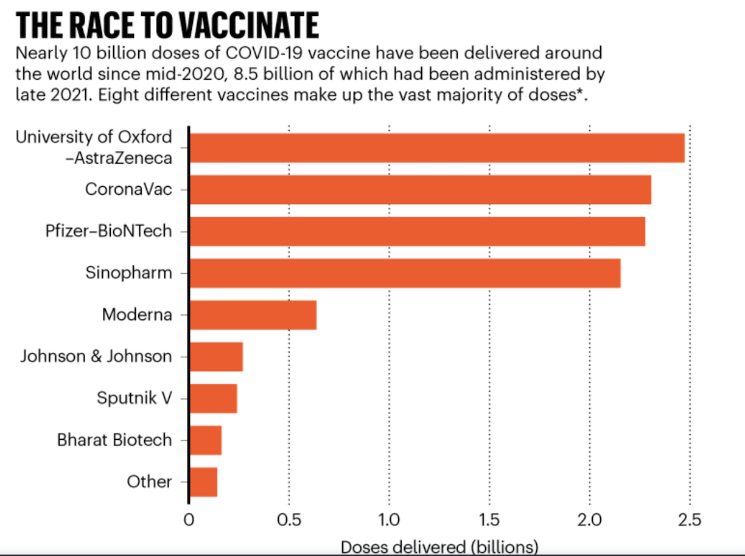

Slide 33
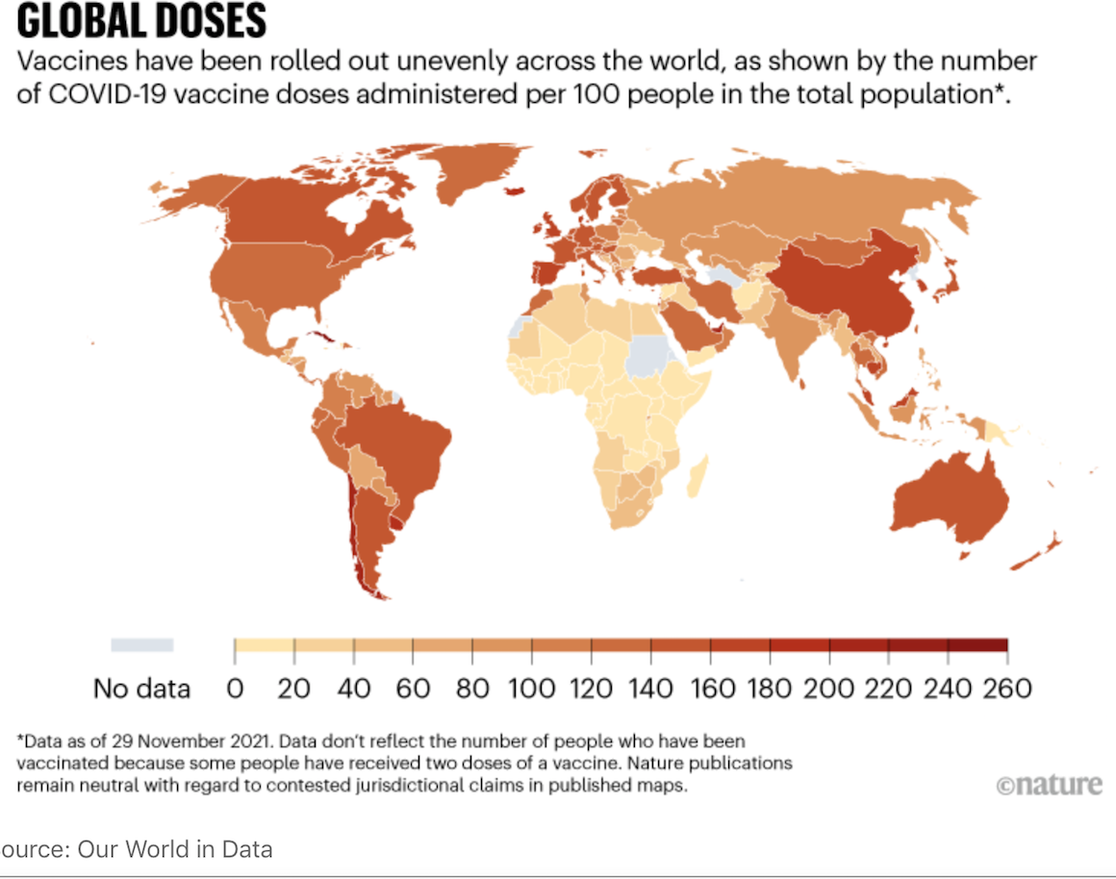

Slide 34
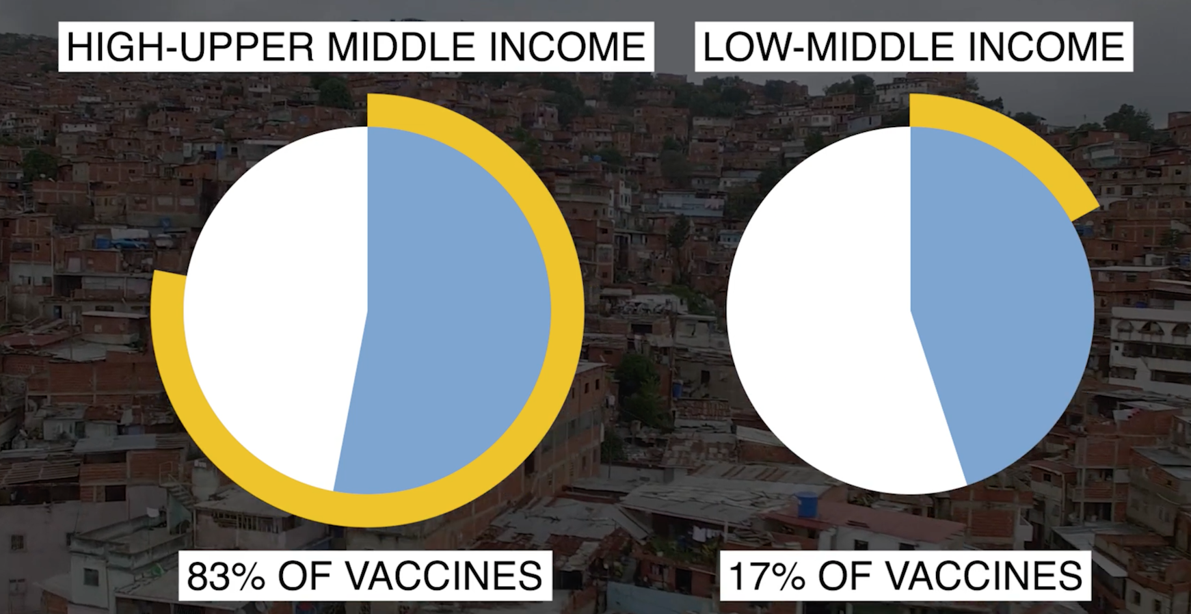

Slide 36
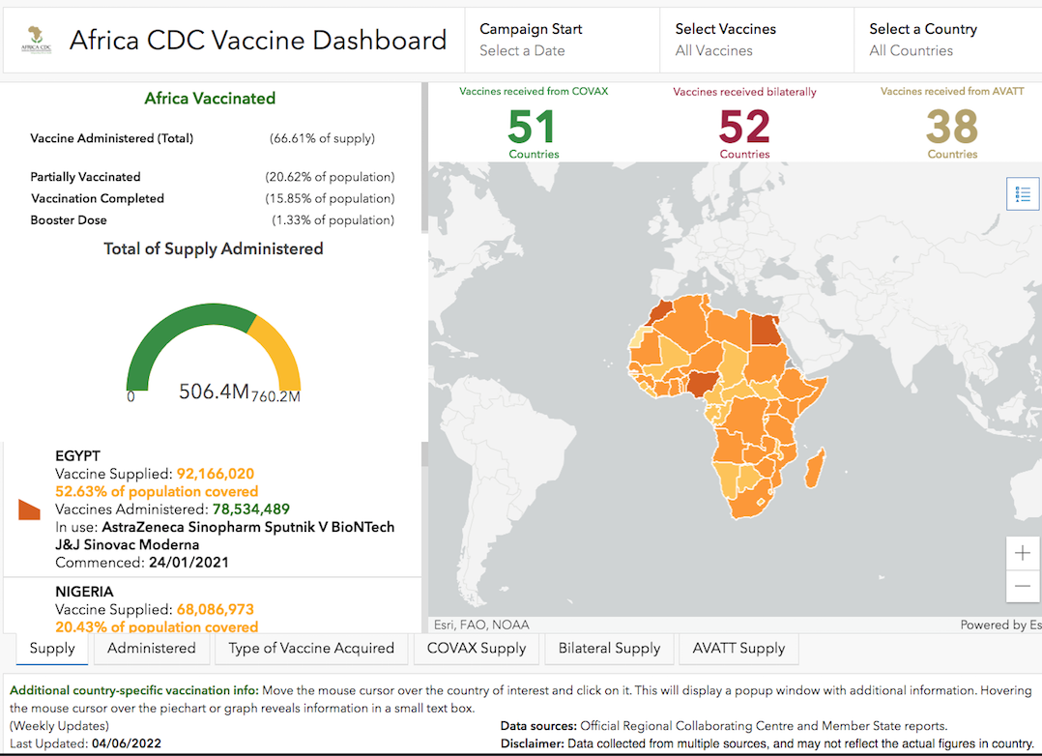

Slide 37
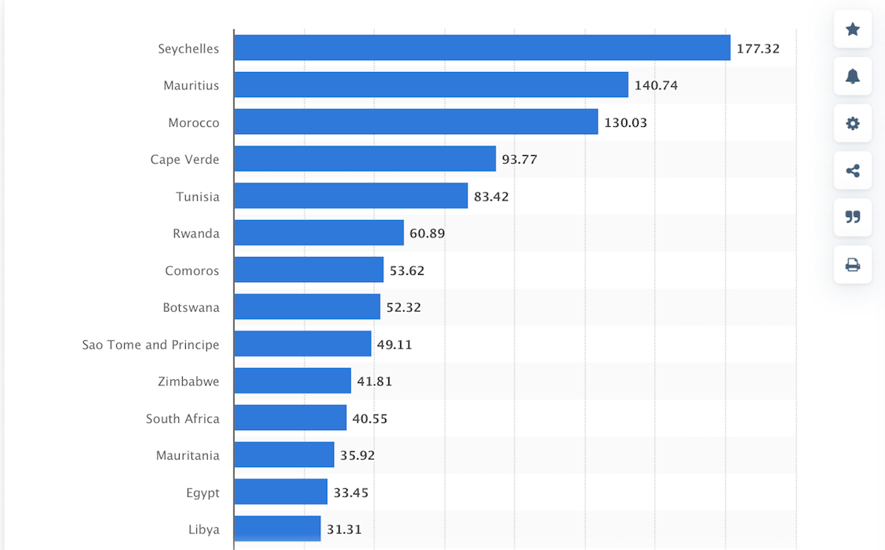
VACCINATION COVERAGE/100 PEOPLE IN AFRICA

Slide 38
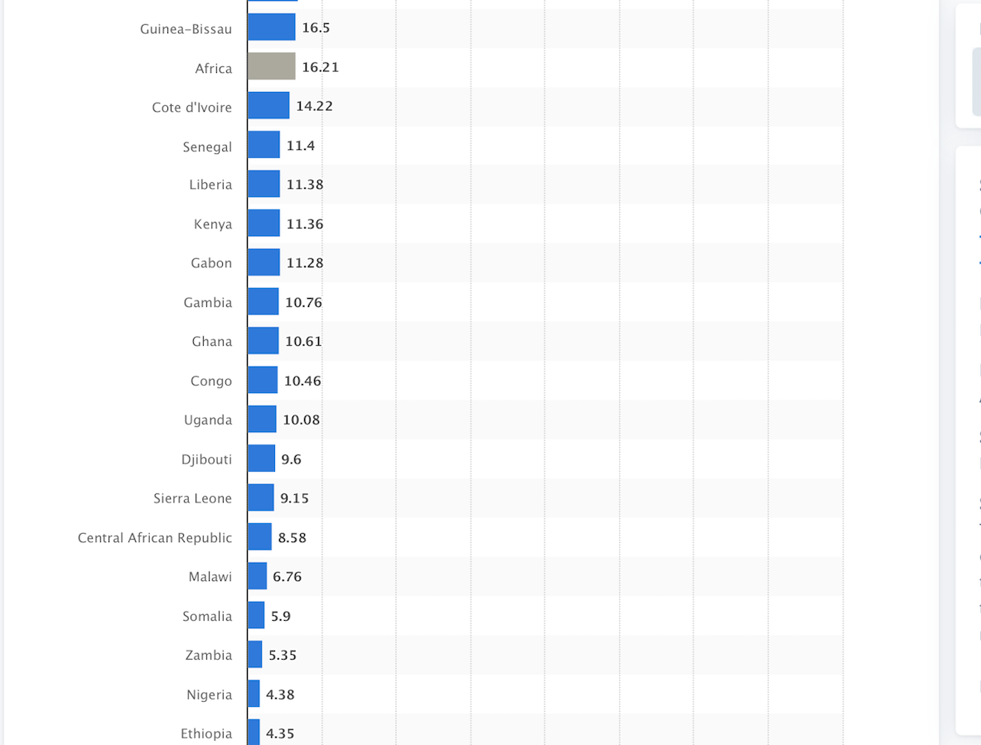
VACCINATION COVERAGE/100 PEOPLE IN AFRICA….2

Slide 39
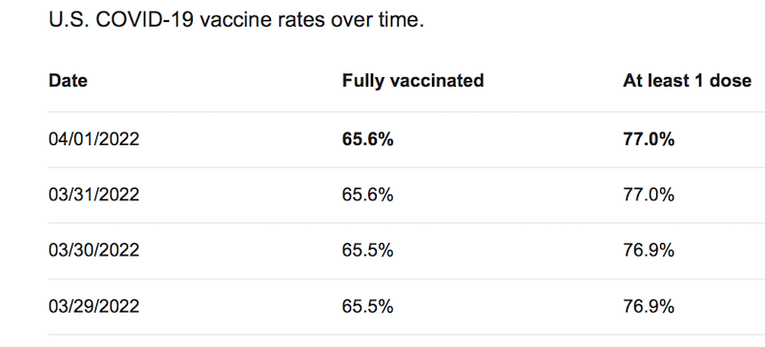
African Vaccination as of March 2022
Africa has fully vaccinated just 15% of the adult population. Of the 714 million doses received so far, 435 million or 61% has been administered. Fifteen countries are yet to reach 10% of their population fully vaccinated. Twenty-one African countries have fully vaccinated between 10% and 19% of their populations. Five countries have fully vaccinated between 40% and 69% of their populations. Only Mauritius and Seychelles have surpassed 70% vaccination coverage.

Slide 40
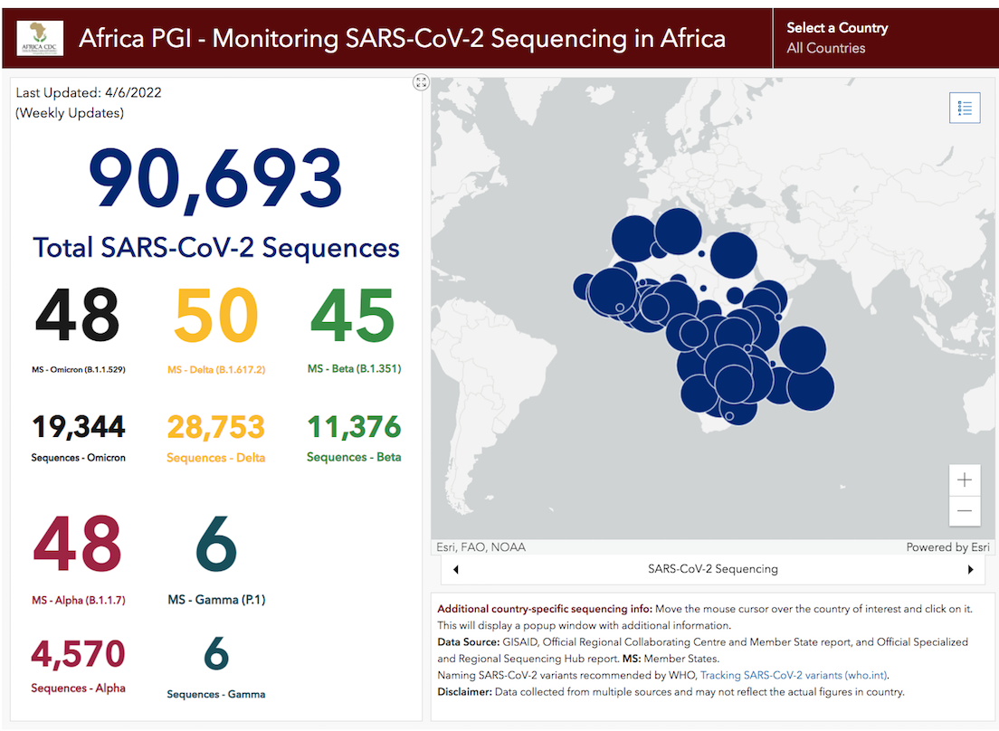

Slide 42
REQUIRED…….Decisive Leadership……1
Female Gender?
Clear Understanding of the threat posed by COVID-19
Need for timely and decisive action
Adoption of Strict Measures
Earlier Implementation associated with better outcomes
Ability to measure impact beyond deaths

Slide 43
REQUIRED…….Decisive Leadership……2
Good coordination
Forward planning
Repositioning the health system
Singapore established a multinational Taskforce ahead of confirmed cases
Reliance on Science and not Politics

Slide 44
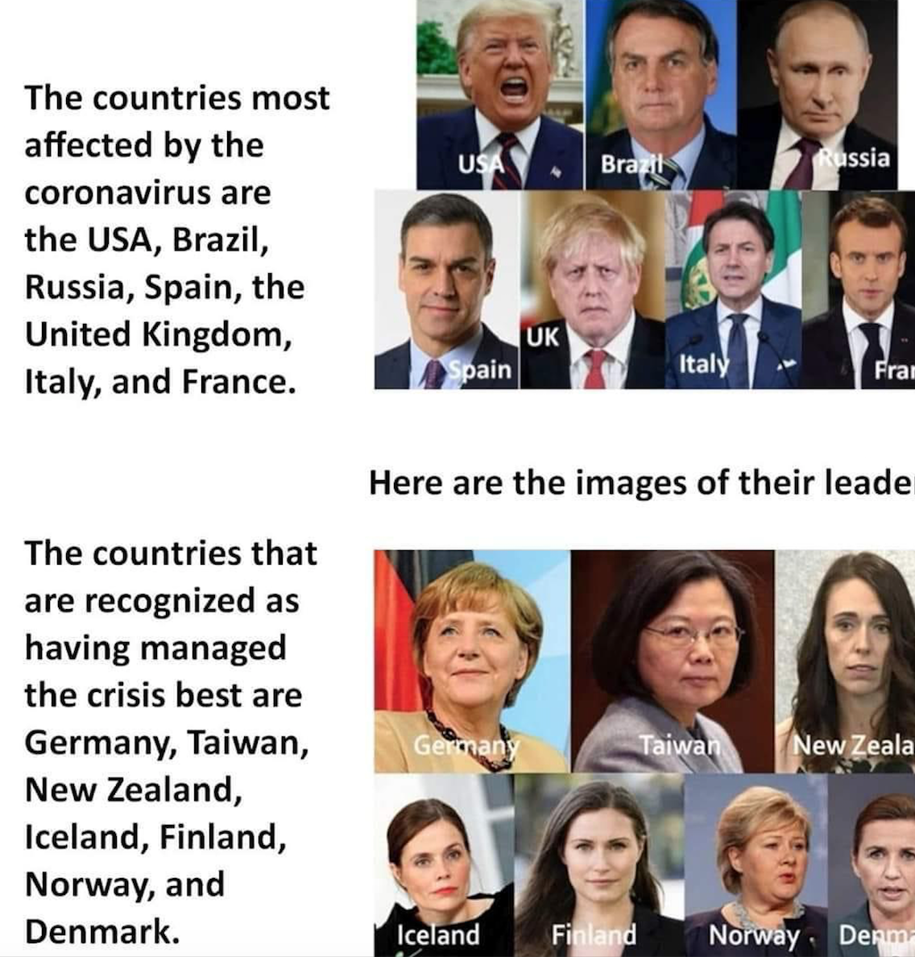
Leadership and Gender ?

Slide 45
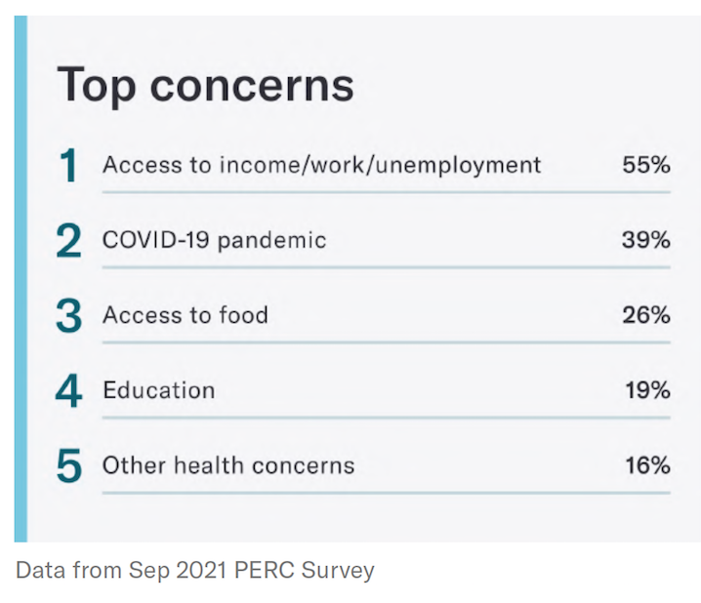
Challenges in Africa
Trust deficit
COVID-19 a MYTH
Inadequate testing
Low priority accorded health
Poor Funding
Fragile healthcare system
Non existing research architecture
Competing health issues

Slide 46
Facilitating Factors for Trust
Family Members
Community leaders
Healthcare Workers
  In Africa only 27% of health workers have been fully vaccinated against COVID-19 as of November 2021.i Personal protective equipment (PPE) is still inadequate or non-existent in some cases

Slide 47
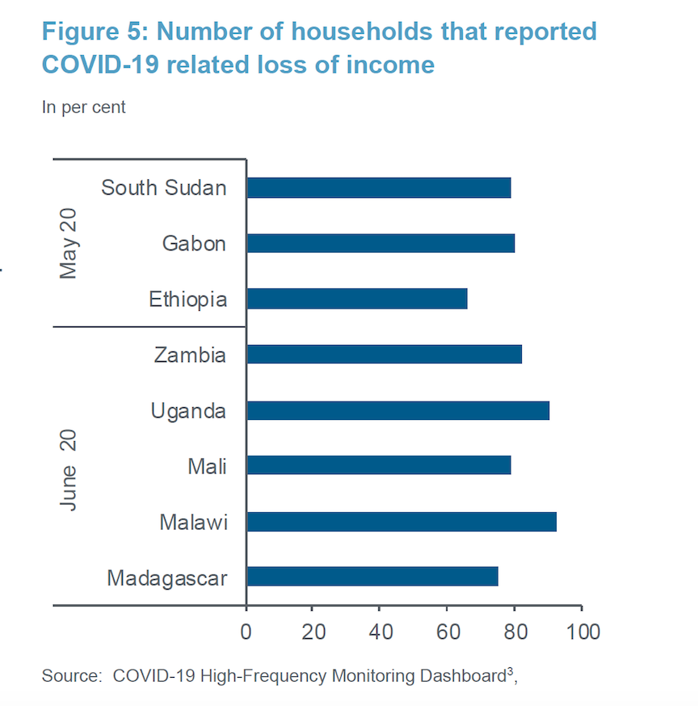

Slide 48
More African based research needed
Socio-cultural impact
Economic costs
Basic and clinical sciences
Epidemiology in Africa
Pathogenesis and disease progression
Drug trials
Vaccine research

Slide 49
Factors impacting Fatality
The male to female ratio among confirmed cases is 1.6, and the median age is 37 years (range: 0 - 105).
African Advantage
Age
Co-morbidities-
  Diabetes
  CVD
  CPD
  Cancer

Slide 50
African Advantage
AGE DISTRIBUTION
HEAT
ENVIRONMENT/PREVIOUS INFECTIONS

Slide 51
AFRICAN RESPONSE
Africa Joint Continental Strategy for COVID-19 outbreak
prevent severe illness and death from COVID-19 infection in Member States;
minimize social disruption and economic consequences of COVID-19 outbreaks. Centralized Process of Technical Support
Multilateral Approach to
Resource Mobilization
Peace & Security
Overall Goal: to promote evidence-based public health practice for surveillance, prevention, diagnosis, treatment, and control of COVID-19.

Slide 52
AFRICA’S RESPONSE
AFRICA CDC
  AFRICA TASKFORCE FOR CORONAVIRUS (AFTCOR)
  AFRICA CDC’S INCIDENT MANAGENT SYSTEM

Slide 53

The report prepared by African Peer Review Mechanisms covered:
  seeks to support the articulation of evidence-based governance responses in member states and to facilitate sharing of tested approaches on the governance response to COVID-19
  this report explores the implications of immediate measures taken to contain COVID-19, which has placed operational constraints on institutions across public and private

Slide 54
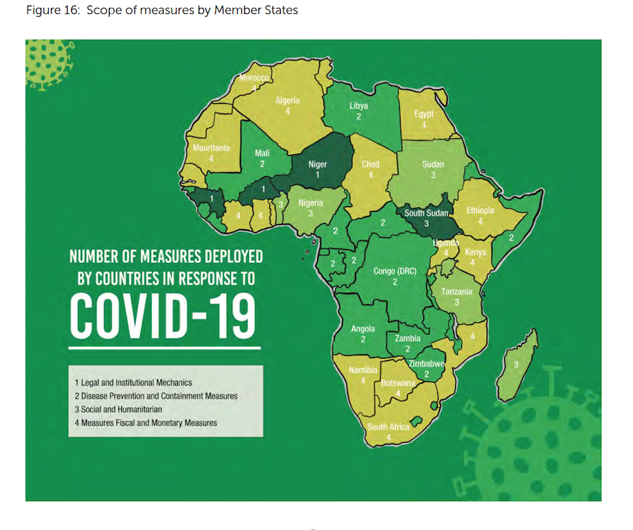
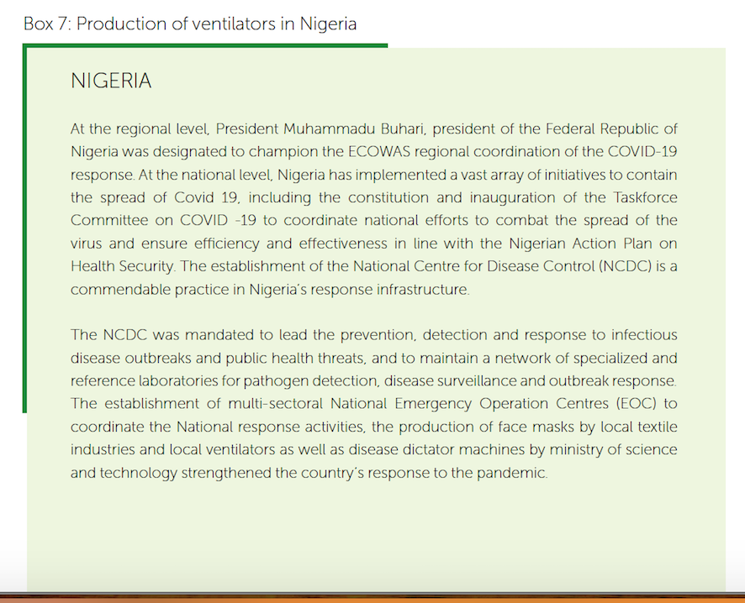
AFRICA’S RESPONSE

Slide 55
Centralised Provision of Technical Support
  Africa CDC has provided important technical expertise and support to African countries as part of Africa Joint Continental Strategy for COVID-19 outbreak through the Africa Task Force for Coronavirus (AFTCOR) in six technical areas:
  surveillance, including screening at points-of-entry;
  infection prevention and control in healthcare facilities;
  clinical management of persons with severe COVID-19 infection;
  laboratory diagnosis and subtyping;
  risk communications;
  supply chain and stockpiling.
Expansion of laboratories testing capacities for COVID-19.

Slide 56
EFFECTS OF THE RESPONSE
The lockdown prevented many people from working thus leading to loss of income for many business owners and their employees
  Some employees sadly lost their job
  Chronic unemployment –→ depression & other chronic health problems
  All components of the social determinants of health were adversely affected
  Relief package in some developed nations but not developing countries
Schools were closed leading to increasing spending at home
Significant rise in the cost of basic home needs including food items
  Poor nutrition has adverse effect on health
Hospitals became selective on patients to be cared for
Health workers got infected and the risk of nosocomial transmission ↗
With low testing rate, risk of transmission became a vicious cycle

Slide 57
HEALTH WORKERS INVOLVEMEMENT
The number of health worker infections continue to increase gradually with 43,868 (3.6%) infections reported in 43 countries since the beginning of the outbreak.
South Africa remains the most affected, with 27 360 (63%) health workers infected, followed by Algeria (2 300), Nigeria (2 175), Ghana (2 065), Ethiopia (1 506), Kenya
(1 029), Cameroon (808), Uganda (592), Guinea (513), Mozambique (484), Namibia (464), Equatorial Guinea
(363), Senegal (349), Eswatini (291), Guinea-Bissau (282) and Malawi (280).
Liberia 16.3% (221/1 354), Niger 15.3% (184/1 200), Guinea Bissau 12.0% (282/2 362), Sierra Leone 10.1% (230/2 277), Sao Tome and Principe 9.6% (88/914), Mauritius 7.6% (30/395) and Equatorial Guinea 7.2% (363/5 052) have the highest country specific proportion of health worker infections among confirmed cases.

Slide 58
Strategic objectives to control spread of COVID-19
Limit human-to-human transmission including reducing secondary infections among close contacts and health care workers, preventing transmission amplification events, and preventing further international spread from cities with ongoing community transmission.
Identify, isolate and care for patients early, including providing optimized care for infected patients;
Identify and reduce transmission from the animal source;
Address crucial unknowns regarding clinical severity, extent of transmission and infection, treatment options, and accelerate the development of diagnostics, therapeutics and vaccines;
Communicate critical risk and event information to all communities and counter misinformation;
Minimize social and economic impact through multi-sectoral partnerships

Slide 59
Health System Re-engineering
Better planning
Funding and Staffing
Capacity Building
Enhanced Research Capability
Clinical Trials Network
Ethics Board/Institutional Review Board
Well equipped Laboratories

Slide 60
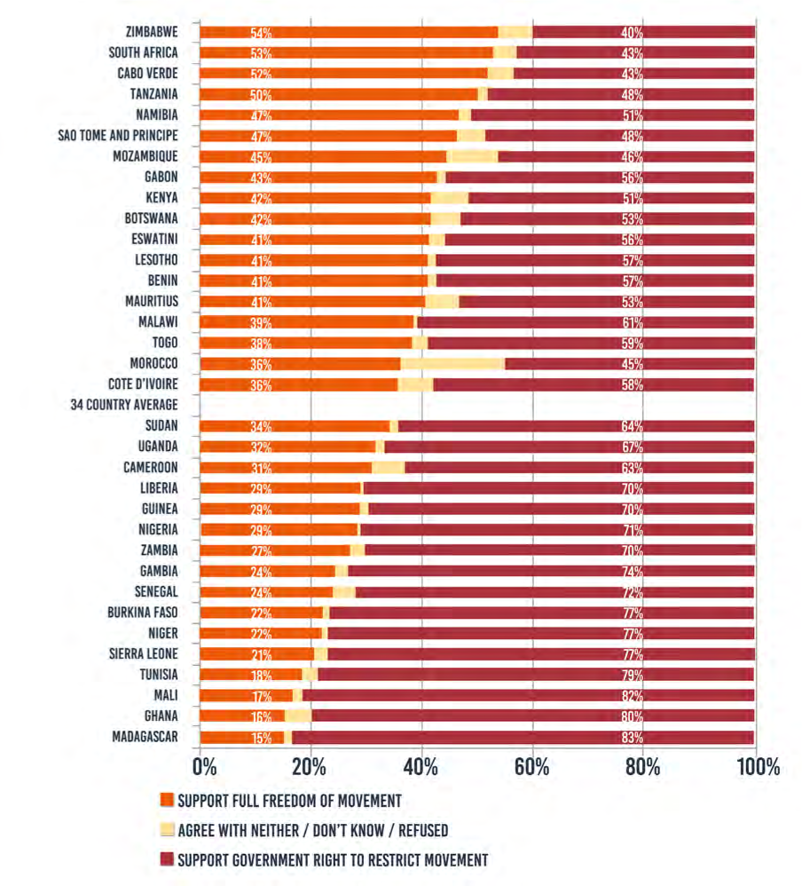
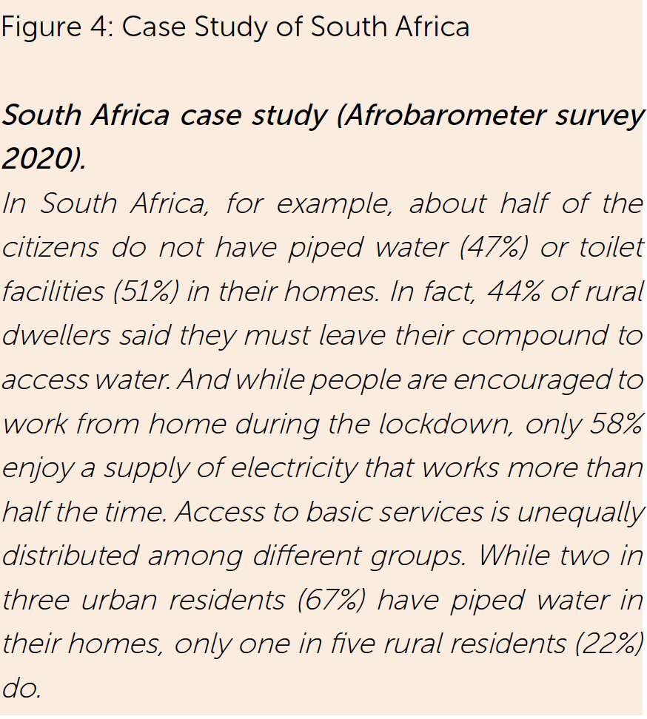
Citizen perception on the legitimacy of quarantine and lockdown
Source: APRM, May 2020

Slide 61

The African Union COVID-19 Response Fund
Target:
The African Union COVID-19 Response Fund aims to raise resources to strengthen the continental response to COVID-19 by
  Support the procurement and distribution of essential COVID-19 medical equipment and supplies and mobilize rapid response by Member States.
  Mitigate the social, economic and humanitarian impact of COVID-19 in all African countries.
  Further boost the capacity of Africa CDC to support response to public health emergencies across the continent.
https://au.int/en/aucovid19responsefund

Slide 62
Private sector Response to COVID-19 in Africa
The private sector response is even more important in resource-constrained African countries.
  The pan-African business organization, AfroChampions—which was created to help fight Ebola—has launched a COVID-19 response fund in partnership with the African Union and the Africa Centres for Disease Control and Prevention (Africa CDC), aiming to raise over $150 million to support the continental response and procure the necessary medical supplies.
  The funds are being contributed by a coalition of African banks, including Ecobank, Standard Bank, and Equity Bank; several private equity firms; and healthcare companies.

Slide 63
Examples of private sector support in COVID-19 Response
Kenya Private Sector response:
  One of the most wide-ranging, ambitious, and comprehensive interventions has been in Kenya.
  A team of startups in ecommerce, clean cooking stoves, and micro-distribution created a platform called Safe Hands Kenya - deployed free soap, hand sanitizer, cleaners and disinfectants, and masks to Kenyans through hundreds of thousands of distribution points.
  In Kenyan Private Sector Alliance: Private hospitals were used to deliver vaccinations while the country’s private sector has gone above this to support the government’s rollout by committing to covering the costs of immunising employees and other members of the community
Nigeria Private Sector response
  The Dangote Group, Access Bank, Zenith Bank, Guaranty Trust Bank, MTN, and KPMG have come together to form the Coalition Against COVID-19 (CACOVID) that is providing financing for immediate purchase of medical supplies and the creation of isolation centers. Guaranty Trust Bank worked quickly to transform a stadium into a 110-bed isolation center within five days in partnership with Lagos State.

Slide 64



Saving Lives and Livelihoods is a groundbreaking Programme with ambitious goals
Programme goals
Purchase COVID-19 vaccines for
>65 million Africans
$1.5bn
Support the delivery of doses to cover at least
70%
of Africa’s population

Slide 65








Saving Lives and Livelihoods Programme | Guiding principles
Seven guiding principles for the Programme
Inclusivity
Equity Accountability
African and country-led Collaboration
Improvements of national health systems
Iteration and learning
Description of the principles
Include all African countries and communities
Reflect countries’ circumstances and needs
Use resources appropriately, efficiently and transparently
Empower African governments, public health institutes and implementing organisations
Work together with Member States and relevant partners in the field and ensure
there is collaboration and no duplicate effort
Strengthen national health systems through smart investment into vaccine deployment without harming routine immunization
Apply a test-and-learn approach while scaling up the Programme, with a focus on knowledge and institution building

Slide 66
Saving Lives and Livelihoods is a joint Programme between Africa CDC and the Mastercard Foundation with four pillars of support
Details to follow
  Pillar I
  Purchase at least 50M COVID-19 vaccine doses
  Pillar II
  Support deployment of COVID-19 vaccine doses
  Pillar III
  Strengthen vaccine manufacturing of human vaccines
  Pillar IV
  Strengthen Africa CDC’s capacity and capabilities

Slide 67










10 areas of support are offered to Member States through Implementing Partners and Africa CDC
X
Supported by partners
X
Supported by Africa CDC
Procurement and logistics to central medical warehouse
In-country logistics
Risk communications and community engagement
COVID-19 vaccination centres (CVCs)
Technical assistance
to countries
Safety surveillance
Genomic sequencing
Implementation science
Data and information systems
Hiring of Programme Staff

Slide 68




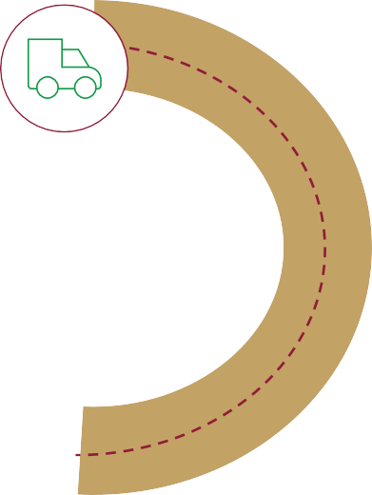






















Level 1 and Level 2 partners map to each of the different activities
ILLUSTRATIVE, MAY DIFFER BY COUNTRY
NON EXHAUSTIVE
Level 1 partners Level 2 partners
Support for Africa CDC’s Programme Management Unit
Others
Member States
Manufacturing
0
Procurement and logistics to central medical warehouse
1
In-country logistics
2
8
Data and
information systems
Genomic
sequencing
Technical assistance to countries
7
Hiring of Programme Staff
9
5
4
3
Implementation science
10
Safety surveillance
COVID-19 vaccination centres (CVCs)
Risk Communication and Community Engagement

Slide 69
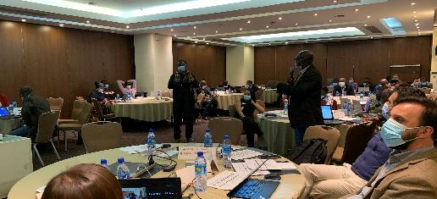
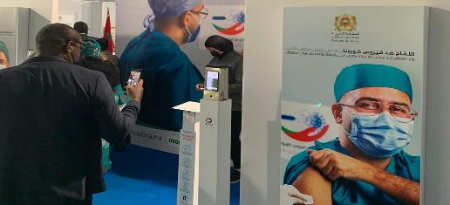
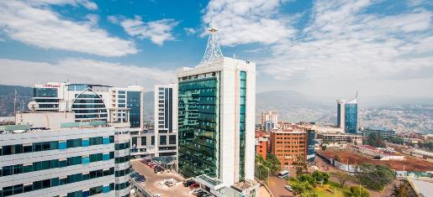
We have kickstarted large scale implementation through a series of workshops for both Implementing Partners and Member States
Partner Orientation
Morocco Workshop
Rwanda Workshop
Addis Ababa, Ethiopia
Casablanca, Morocco
Kigali, Rwanda
Introduction to SLL Programme, kickoff and onboarding for implementing partners
Meeting of Member States and partners
Sharing best practices & pharmacovigilance of Morocco’s vaccine rollout
Meeting of Member States and partners
Laying the foundations for microplanning and programme delivery
50+ attendees
12 partners
45 attendees
14 Member States, 11 partners
3 guest organizations
~80 attendees
29 Member States, 12 partners
3 guest organizations

Slide 70




The definition of the support from the Programme through the Implementing Partners to the Member States is made up of 4 stages
Preliminary needs identification
Country
engagement
Country support
plan development
Micro-plan
development
Process description
  Collect data on countries’ needs through an online survey in collaboration with Member States, including existing plans and a preliminary identification of existing vaccination capabilities
  Align on areas of support for each country and choice of partners, in collaboration with each Member State
  Develop country support plan and high-level budget to provide Member State and implementing partner with overall allocated budget and areas of support for microplanning
  Member State and implementing partner to develop detailed micro-plan and budget
Initiative announcement
Confirmation of
support
Implementation
of support

Slide 71
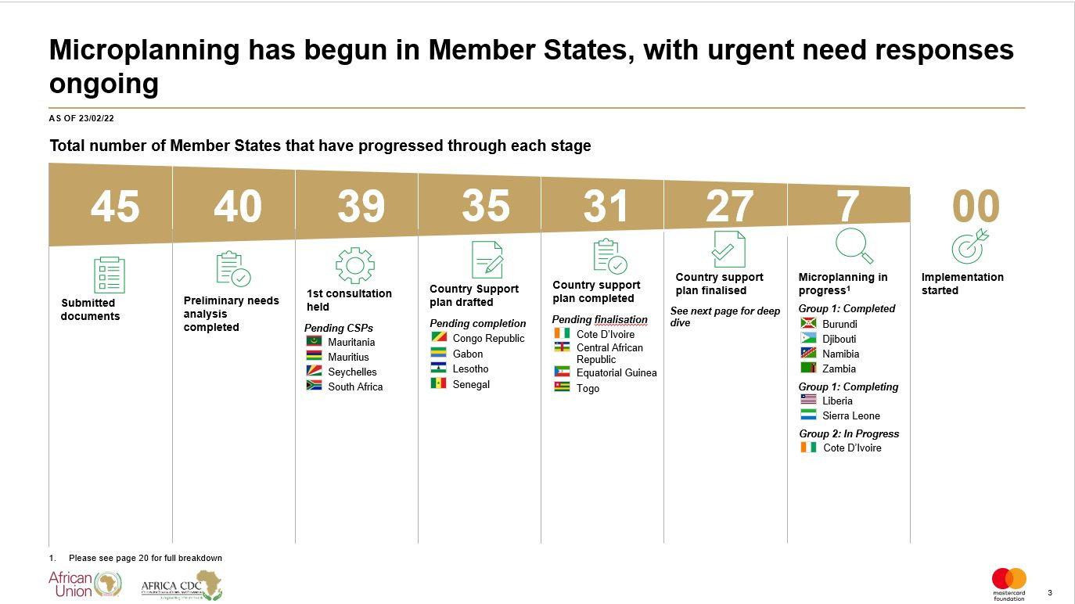

Slide 72
Country Strategic Approach
The strategy in place are :-
Leadership coordination in liaison with FMoH, NCDC and Presidential Taskforce on COVID-19 and key partners towards effective control of the current COVID -19 outbreaks in Nigeria.
Minimize the impact of the Covid-19 pandemic on PHC service provision and ensure the availability and adequacy of medicines, equipment and other essential commodities in the event of a surge in patient care needs
Leverage existing structures to strengthen surveillance and case detection of Covid-19 at PHC and community level
Development and implementation of a robust COVID-19 risk communication plan
Provision of capacity building and support to health care workers on COVID-19 prevention and control.

Slide 73
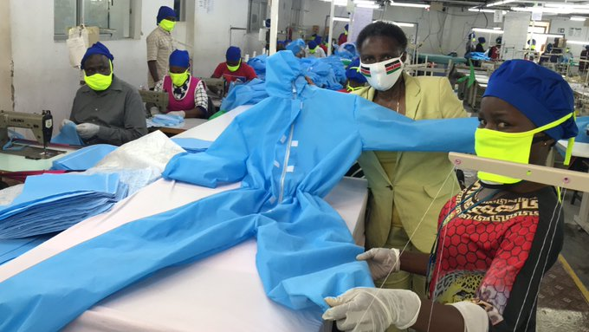
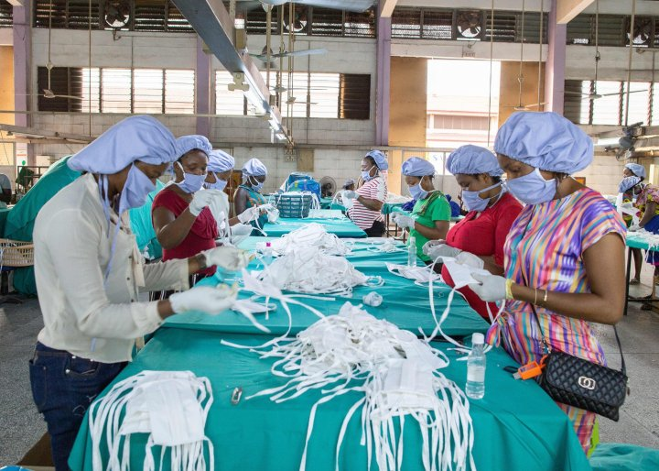
Innovations – local production of PPEs
Face mask/cloth
Hazmat suit

Slide 74
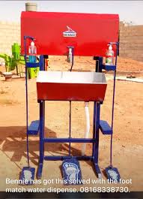
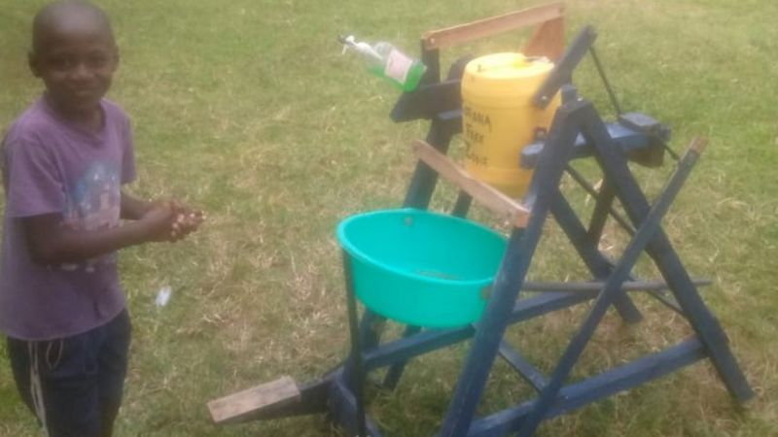
semi automatic hand wash machine

Slide 75
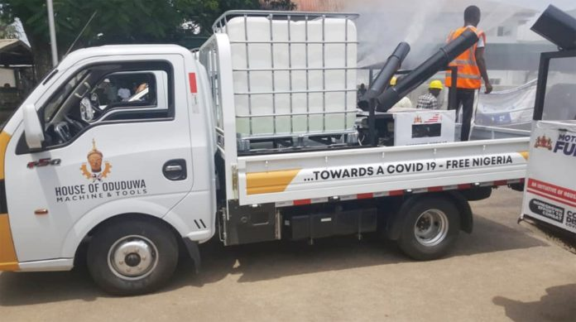
Motorised modular spraying equipment locally assembled

Slide 76
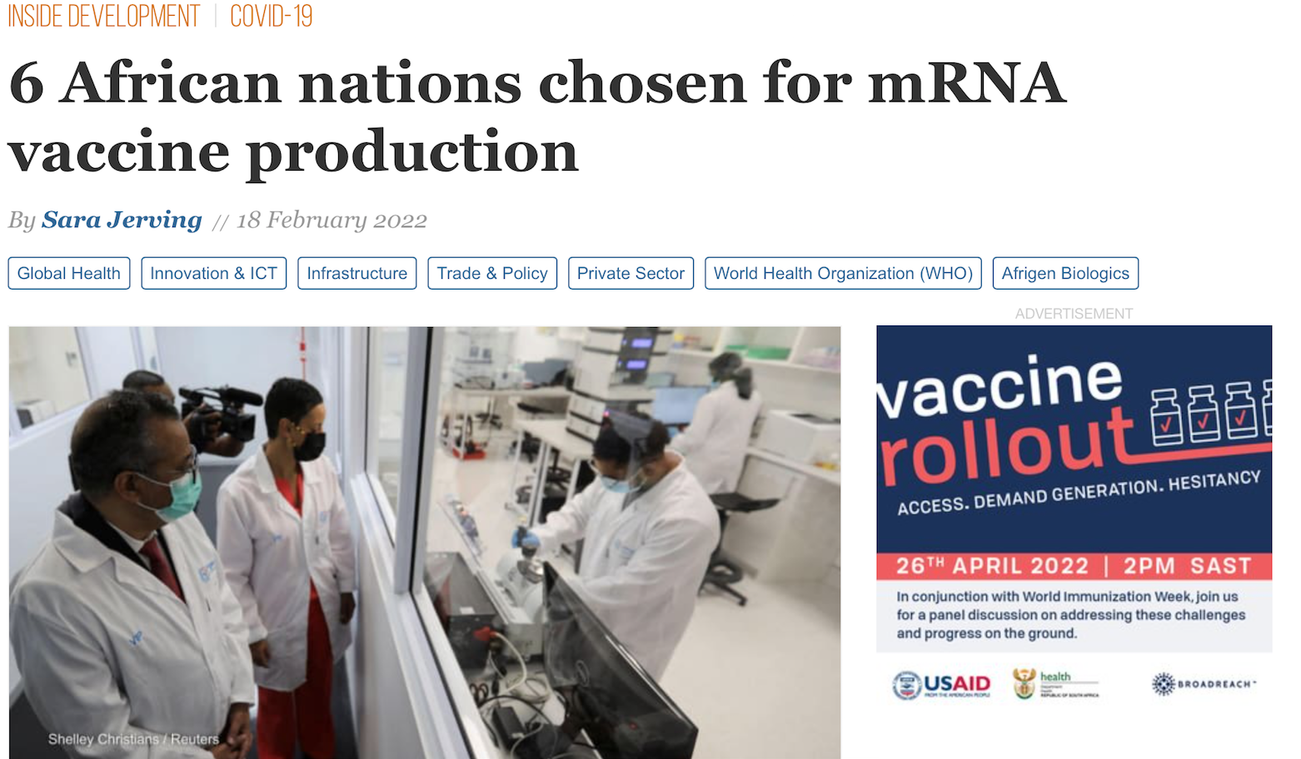
VACCINE PRODUCTION IN AFRICA
The World Health Organization announced the first six countries chosen to receive the tools needed to produce messenger RNA vaccines in Africa: Egypt, Kenya, Nigeria, Senegal, South Africa, and Tunisia.

Slide 77
Conclusion
Secondary burdens, including reduced access to income, food and health care have been exacerbated by the pandemic. COVID-19 severely impaired economic growth across Africa and plunged the continent into a recession, with average GDP contracting by 2% in 2020. The ongoing pandemic has the potential to push over 40 million additional people into extreme poverty. Due to macro-level factors affecting agricultural outputs and export prices, it is also likely to increase food insecurity and unemployment across the region. In the most recent PERC survey, respondents cited access to income and employment as their greatest concern, followed by COVID-19 and access to food. Health systems are stretched as health care workers continue to be under-resourced, overworked and underpaid. Public health gains from the past several decades are either at a standstill or reversing, which is alarming and devastating for already-fragile health systems. ……PERC-Finding the Balance

Slide 78
Conclusion……..2
COVID-19 is real
Africa must look inwards
Political Commitment and Action needed
AU/WHO AFRO/ACDC/Country CDC
Ministries of Education, Health, Science and Technology
Build and sustain structures to execute pan-African initiatives on drugs and vaccines
Plan for the next Disease Outbreak

Slide 79
Need for pro-activeness
JEE-June 2017-Verdict-Not ready (39%)
Investment needed-N130/capital /year
NAPHS:Total cost- N134 Billion($439mil)
National Strategy on Immunization and PHC System Strengthening (NSIPSS)
N81Billion ( $265 million)

Slide 81
THANK YOU ALL FOR LISTENING

