Slide 1
Robert Hornik
COVID-19 research lab
(Leeann Siegel, Kwanho Kim, Chioma Woko
Emma Jesch, Ava Kikut, Danielle Clark)
Annenberg School for Communication
University of Pennsylvania
rhornik@asc.upenn.edu

Slide 2
Three components of this talk
The study and the vaccination outcome measure
Background interesting results
Results specific to potential communication interventions
Notes:
Clarification questions any time
Substantive questions at the end.

Slide 3
The study
Nationally representative adult sample (SSRS opinion panel): online and phone
Three waves of same respondents
T1 May 2020: n=1074
T2: June 2020: n=889
T3: April/June 2021: n=750 (70% retained)
Weighted to Current Population Survey, major demographics

Slide 4
Vaccination outcome status measures
Intentions (T1, T2, T3)
If you were able to get a vaccine for coronavirus today, what is the likelihood that you would get vaccinated?
Very likely
Somewhat likely
Somewhat unlikely
Very unlikely
Behavior (T3 only)
Have you received at least one dose of any of the COVID-19 or coronavirus vaccines?
No/Yes
Are you now fully vaccinated?
No/Yes

Slide 5
Vaccination outcome variables
Variable | % somewhat or very likely | % somewhat or very unlikely
Intentions T1 | 67% | 33%
Intentions T2 | 63% | 37%
 | Yes | No
At least 1 vaccine dose T3 | 57% | 43%
At least one vaccine dose or somewhat or very likely T3 | 74% | 26%
Notes:
Notes:
These are for a sample 18+; these numbers are reasonably consistent with national estimates at the same times in 2021.
The T3 sample was half gathered in April of 2021 and half in June 2021; there was a sharp shift in the proportion of the population with any vaccination between those dates. 52% in April; 64% in June, but the proportion with at least one dose or saying they were likely to be vaccinated was substantially unchanged: 73% in April; 75% in June. (Also the proportion fully vaccinated and 2 weeks after last shot was sharply up by June: of those with any vaccination 50% in April and 93% in June reported full+2 weeks after final shot.)

Slide 6
Intention strongly predicts behavior one year later when vaccines available.
67% |  | Intention T1 (April 2020) |  | Intention T1 (April 2020)
 |  | % Very likely | % Somewhat likely | % Somewhat unlikely | % very unlikely
At least one vaccine dose or somewhat or very likely T3 (April-June 2021 | Yes | 90% | 82% | 65% | 38% | 74%
 | No | 10% | 18% | 35% | 62% | 26%
 |  | 40% | 27% | 13% | 20% | N=748
Notes:
Notes: Strong relationship: gamma =.65. People can predict their own behavior
(the relationship is parallel if the outcome is actually getting a vaccination
81%, 48%, 51%, 26% gamma =.59.
Of interest: although a substantial majority follows through on their intentions, some do not:
Nearly 40% of those who said they were very unlikely in spring of 2020, and nearly 2/3 of those in the somewhat unlikely category had moved to the pro-vaccine status by summer 2021.
And vice-versa around 10% of those who said they were likely in spring of 2020 had not been vaccinated and no longer intended to by summer of 2021. (although because the likely groups were much bigger than the unlikely groups– the absolute percentage of the whole population who shifted up or down is more comparable.)
We are quite curious about why these people changed their minds, but I will leave that for our ongoing research agenda

Slide 7
Part 2: Background predictors and correlates of vaccination status at T3 (April/June 2021)

Slide 8
Most of the predictors of who will get vaccinated (or be likely) in June are as expected: Age
 |  | Age |  | Intention T1 (April 2020)
 |  | 18-29 | 30-49 | 50-64 | 65+
At least one vaccine dose or somewhat or very likely T3 (April-June 2021 | Yes | 68% | 70% | 76% | 84% | 74%
 | No | 32% | 30% | 24% | 16% | 26%
 |  | 21% | 34% | 25% | 21% | N=746
Gamma= .223
Notes:
Notes: I will go through most of these bivariate results quickly. They mostly confirm expectations.

Slide 9
Most of the predictors of who will get vaccinated (or be likely) in June are as expected: Education
 |  | Education |  | Intention T1 (April 2020)
 |  | HS or less | Some college | College grad
At least one vaccine dose or somewhat or very likely T3 (April-June 2021 | Yes | 66% | 73% | 85% | 74%
 | No | 34% | 27% | 15% | 26%
 |  | 38% | 28% | 34% | N=746
Gamma= .343
Notes:
Notes:

Slide 10
Most of the predictors of who will get vaccinated (or be likely) in June are as expected: Metro area
 |  | Metro residence
 |  | Metro | Non-metro
At least one vaccine dose or somewhat or very likely T3 (April-June 2021 | Yes | 79% | 64% | 76%
 | No | 21% | 36% | 24%
 |  | 81% | 19% | N=692
Gamma= .357
Notes:
Notes:

Slide 11
Most of the predictors of who will get vaccinated (or be likely) in June are as expected: Currently insured
 |  | Insured?
 |  | No | Yes
At least one vaccine dose or somewhat or very likely T3 (April-June 2021 | Yes | 50% | 77% | 74%
 | No | 50% | 23% | 26%
 |  | 12% | 82% | N=748
Gamma= .544
Notes:
Notes: Are you currently covered by health insurance?
This is a bit of an odd result, given that there is no cost, and apparently universal access to vaccination.
The great majority report being insured, but those that are not insured report sharply lower levels of the vaccination outcome. Is this merely an indicator of other attributes that make people reluctant vaccinators? Or can it reflect some concern about cost, even though the vaccination is available at no cost and without making use of the health system.

Slide 12
Most of the predictors of who will get vaccinated (or be likely) in June are as expected: Religious identity
 |  | Age |  | Intention T1 (April 2020)
 |  | None/other | Catholic | Other Christian
At least one vaccine dose or somewhat or very likely T3 (April-June 2021 | Yes | 80% | 81% | 68% | 76%
 | No | 20% | 19% | 32% | 24%
 |  | 38% | 28% | 34% | N=746
Notes:
Notes: Catholics, and those who report no religious affiliation (or Jews Muslims, Hindus, of whom we have few) are different than other Christians (who themselves can be further differentiated.)

Slide 13
Most of the predictors of who will get vaccinated (or be likely) in June are as expected: Political Party
 |  | Age |  | Intention T1 (April 2020)
 |  | Republican | Democrat | Independent
At least one vaccine dose or somewhat or very likely T3 (April-June 2021 | Yes | 65% | 84% | 70% | 74%
 | No | 35% | 16% | 30% | 26%
 |  | 26% | 37% | 31% | N=741
Notes:
Notes: The Republican- Democrat difference is probably unsurprising, but I admit being surprised by the fact that Independents were closer to Republicans than to Democrats.

Slide 14
Misinformation items (T1-Spring 2020)
Information about treatments for coronavirus is being suppressed by those who want the pandemic to continue
Coronavirus was created in a lab
The coronavirus is not more dangerous than the seasonal flu
Coronavirus is probably a hoax
Public health authorities are exaggerating the seriousness of coronavirus
A vaccine for the coronavirus is now available
The malaria drug Hydroxychloroquine is an effective treatment for coronavirus
A cure for coronavirus has been found
Coded 1:strongly disagree, 5: strongly agree; Cronbach’s alpha summed scale=0.84
Notes:
This one I will take a little more time with, although the end result will be unsurprising:
We created a scale, reflecting responses to 8 items which were at the time we developed them were fairly widespread, but generally considered false. We arrayed people on a summed scale reflecting how many of these items they agreed with. It was a very good scale.

Slide 15
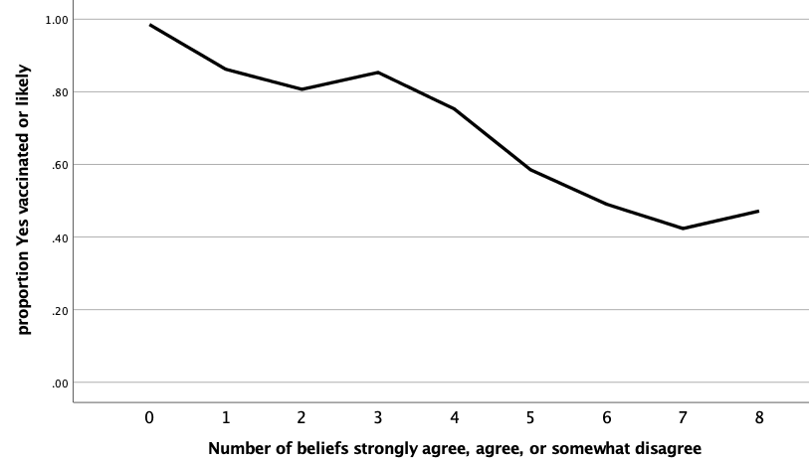
Association of T1 misinformation & T3 vaccination outcome
Notes:
This graph uses a parsimonious version of the misinformation scale to make he graph easier to read – counting the number of the 8 beliefs that people did not strongly disagree with. The overall correlation between misinformation at T1 and the T3 vaccination outcome, when we use the full version of the misinformation scale, is .45 (gamma is ,60). Almost everyone who rejected the misinformation items was vaccinated or intended to be in 2021.

Slide 16
Support for government restriction items (T1-Spring 2020)
The federal/state government should restrict the gathering of people to stop the spread of the coronavirus.
The federal/state government should provide small businesses financial support to keep them afloat until it is safe to reopen
The federal/state government should give financial support to individuals until it is safe to go back to work
The federal/state government should consider public health more than economic risks when setting policies about the coronavirus
The federal/state government should be allowed to force people into self-isolation if they are infected
The federal/state government should require that anyone in public places wear a face mask
The federal/state government should move quickly in loosening restrictions on businesses (reversed)
The federal/state government should allow most businesses to re-open even if there is some risk to health (reversed)
Coded 1:strongly disagree, 4: strongly agree; Cronbach’s alpha summed scale=0.84
Notes:
This scale shows a similar result – these items mostly contrast government controls with economic risk and again produced a very good scale.

Slide 17
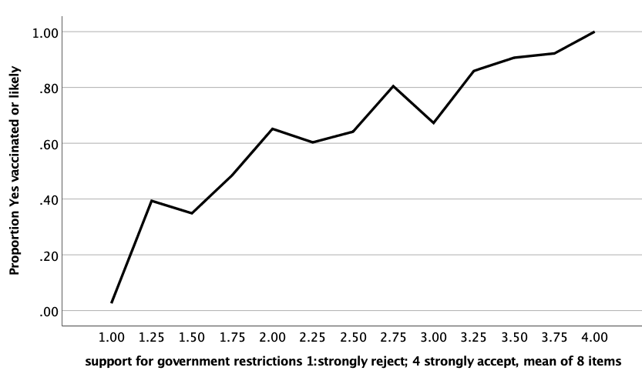
Association of T1 Government restrictions & T3 vaccination outcome
Notes:
This graph show the strong relationship between Spring 2020 acceptance of the role of government restrictions and vaccination acceptance one year later. Correlation .38.

Slide 18
But then there are some less obviously expected results

Slide 19
Most of the predictors of who will get vaccinated (or be likely) in June are as expected: but not Sex
 |  | Sefl-reported gender
 |  | Male | Female
At least one vaccine dose or somewhat or very likely T3 (April-June 2021 | Yes | 74% | 74% | 74%
 | No | 26% | 26% | 26%
 |  | 48% | 52% | N=749
Gamma= .01
Notes:
Notes: Other studies have suggested different rates of uptake for men and women, but as you see here, we did not see evidence for that.

Slide 20
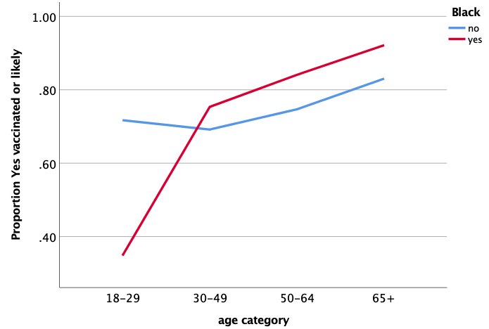
Black respondents lower on vaccination outcome, but only if they are young
At T1: Black respondents were less ‘very likely’ to intend to be vaccinated than non-Black respondents: 23% vs. 43%
By T3: the overall difference in our vaccine outcome measure was minimal: 71% versus 74%.
But there was still a striking difference, but only among young respondents
Notes:
Black respondents were actually higher on T3 vaccination status, except for those in the lowest age group (although our sample of Black young people was not large.).

Slide 21
Among the unvaccinated: an expected mandate is influential
 |  | Expect Mandate
 |  | No | Yes
Somewhat or very likely to be vaccinated T3 (April-June 2021 | Yes | 27% | 63% | 40%
 | No | 73% | 37% | 60%
 |  | 64% | 36% | N=317
All measures at T3,
Asked: Do you think you will be required to get vaccinated against the coronavirus to return to work, to school or for another reason this year?
Notes:
Among the currently unvaccinated (about 42% of T3 respondents), those who expect to face a mandate are much more likely to say they are likely to become vaccinated. In contrast to all the prior analyses this association is based on measures taken at the same time, so causal direction is uncertain, but the size of the association is striking. While we are often hearing stories about people who have quit their jobs rather than accept a vaccine mandate, most of our currently unvaccinated respondents who expect to face a mandate indicate they would be willing to be vaccinated!

Slide 22
Part 3: results relevant to communication interventions

Slide 23
Major decisions when considering communication interventions
What beliefs to focus on
Who should be the sources for messages
What should specific messages look like
How to diffuse messages to assure repeated exposure
(Given limited time, the rest of my comments will focus on the first of these decisions.)
Notes:
Campaigns must make choices—
About what beliefs they will address and what arguments they will make for persuading their audience to adopt a recommended behavior– in this case getting a COVID vaccination
About what sources should present the argument– celebrities, public health authorities, ordinary medical clinicians, ordinary people…
About what the detailed messages should look like
About how to assure diffusion of messages – so all audience members are exposed and exposed frequently.
But I have only 10 minutes left, so I will focus only on the first of these questions – which beliefs deserve priority – and a method we have recommended for making the choices.

Slide 24
Some candidate beliefs for campaign focus
Efficacy for protecting self
Efficacy for protecting others
Other benefits for oneself
Costs of vaccination
Safety - long term
Safety – short term
Descriptive norms- are others doing it?
Subjective norms – do others expect you to do it?
Concerns about being exploited
Trust in public health sources
Notes:
These are all possible beliefs that a campaign might address;, which of these deserve priority; is the priority different for different groups?
Theory and experience with other behaviors as well as discussions of this vaccine– tell us that there are many possible themes that messages can address– from beliefs about benefits to oneself, to others, to concerns about costs and safety, to logistic knowledge about the process of vaccination, to beliefs about who else is getting vaccinated, and whether people important to you are also getting vaccinated, as well as concerns about whether Big Pharma is exploiting people, or whether sources of information can be trusted, This is a quick list; there are many other potential influential beliefs as well. The issue for campaign planners is which of these (and others) deserves to be a priority message for a campaign. Which of them, if only a campaign could persuade its audience to believe in them, would produce the biggest gain in vaccination uptake. Are the priorities different for different subgroups of the population?
In my last few slides, I want to take you through an example for how one might choose among potential priority beliefs. And then report results for some of the range of beliefs we measured
Some of the beliefs I will look at come from the 2020 T1 and T2 surveys and will involve prediction of later behavior; others will be measured at the same time as the focus outcome. The prior measures permit stronger causal claims; the later measures are much more numerous and allow consideration of a wider range of themes.

Slide 25
How much potential effect on intention would a campaign focused on each belief have?
 | …You would be protecting your family and close friends from getting infected
 | Strongly Disagree | Somewhat disagree | Somewhat agree | Strongly agree | Average outcome | Gain in outcome
% vaccinated or likely | 20% | 22% | 80% | 98% | 74% | 24%
Proportion of sample expressing level of agreement | 10% | 13% | 33% | 44%
Notes:
How do we estimate the potential for each belief. Here I take you through one example:
We essentially ask two questions:
How well do responses to a belief predict vaccination or willing to be vaccinated:
How many people do not already accept the strongest pro-vaccine belief?
In this example we see a very strong relationship between the belief that you would be protecting family and close friends from getting infected , measured at T3 and the vaccination outcome.
Overall, 74% express the strong vaccination status outcome.
But that outcome varies sharply with level of belief. For those who somewhat or strongly disagree with this belief (and about 25 out of 100 do) only 21% are high on the outcome. In contrast, for those who somewhat agree, the intention percentage goes up to 80%; and for those who express strong agreement– the percentage goes all the way up to 98%, About 45% of the population was expressing strong agreement in 2021.
So, imagine that the relationship between this belief and the vaccine outcome was causal, and you built a completely successful campaign and convinced everyone to strongly agree with this belief; then in this hypothetical world, we would predict that 98% would move into the vaccination/likely category. So, right now the overall level was at 74% (the purple number) If everyone had the same 98% vaccination outcome as this strong agreement group. the percentage gained would be 24% (98-74). (The red number in this chart.)
We will use this number, which we call percentage to gain) to capture, the maximum potential for each of the beliefs as a target for the campaign.

Slide 26
Two versions of this belief assessment analysis
A set of beliefs that we measured at T2: how well do they predict the vaccination outcome at T3, adjusting for Intentions at T2?
A larger set of beliefs we measured at T3: how strongly are they associated with the vaccination outcome?

Slide 27
We look at 6 beliefs measured at T2? Which of them predict vaccine status in 2021, beyond intentions T2?
 | Percentage to gain
you could trust information you receive from public health officials about the vaccine | 21%
you would be well protected from getting infected with the coronavirus | 18%
you would be protecting others in your community from getting infected | 17%
you would suffer bad side effects from the vaccine (disagree) | 14%
it would be a financial burden (disagree) | 14%
you could be a test subject for a vaccine with unknown consequences (disagree) | -8%
Notes:
We see here the percentage to gain estimates, adjusted for intentions measured at T2: Again, these are the estimates of maximum potential gain from a campaign focused on this belief, from the start level of 74%. five of our 6 candidate beliefs look promising; one of them (being a test subject) is less promising in this analysis, indeed promises a boomerang result. This would suggest that a campaign focused on persuading the audience as to the pro-vaccine side of these five beliefs would be worth considering. It suggests that it would increase their vaccination outcomes even after accounting for the influence of the intentions already formed at T2.
The population baseline estimate is that 74% of the respondents are vaccinated or likely to be vaccinated. The percentage to gain are estimated of the potential extra % who might be in that category if everyone accepted this belief completely. It represents the potential that a campaign focused on that belief might achieve, if the relationship between the belief and the outcome was causal, and a campaign was perfectly successful in changing the belief.

Slide 28
We look at beliefs measured in 2021? Which are associated with vaccine status? Safety and Efficacy
Safety for self (e.g) | Percentage to gain
You would experience serious side effects for longer than a few days (disagree) | 25%
Efficacy for self (e.g.) | Percentage to gain
You would be well protected from getting seriously ill from the coronavirus | 22%
You would be well protected against new variants of the coronavirus | 20%
Efficacy for others (e.g.) | Percentage to gain
You would be protecting your family and close friends from getting infected | 24%
Notes:
The next three slides present additional/parallel example beliefs all measured on the same survey instrument as the vaccination status outcome.
Here we are only looking at cross-sectional associations and not adjusting for prior intentions.
Still, some of these beliefs will be promising targets and others less so. Just to make it clear, though, these are a selection of a larger set of beliefs that we measured. But I wanted to focus the discussion on these useful and contrasting examples. They are only a subset of the belief measures we have available to us at T3.

Slide 29
We look at beliefs measured in 2021? Which are associated with vaccine status? Norms
Descriptive Norms | Percentage to gain
How many of your four closest adult friends or family members have received at least one dose of a COVID-19 vaccine? (3 or 4) | 14%
Subjective norms | Percentage to gain
Do most people who are important to you approve of you getting vaccinated against the coronavirus? | 10%
Notes:
We also examined social normative predictors of T3 vaccination status. While both of these measures are highly associated with the vaccination status outcome, the great majority of the the respondents already reported that most of their four closest friends were vaccinated, and would approve of their being vaccinated – so the potential gain from addressing these themes (even were they possible to change through a communication intervention) is smaller than for the safety and efficacy beliefs.

Slide 30
We look at beliefs measured in 2021? Which are associated with vaccine status? Other examples
 | Percentage to gain
Drug companies are pushing vaccination just to make a lot of money (strongly disagree) | 22%
The companies that developed the vaccines worked too fast (strongly disagree) | 19%
How do you feel about the possibility that you or someone in your immediate family might catch the coronavirus? (very worried) | 17%
It was/would be difficult to sign up for a vaccine appointment | 4%
You would not have to wear a mask or social distance in public places | -2%
Notes:
Finally here are some example beliefs that do not fall into the categories of safety, efficacy, of social expectations. Three of them suggest beliefs that might be worth addressing since they seem to be getting in the way of accepting vaccines.
In contrast two other don’t seem to suggest a major concern, requiring intervention – perception of the difficulty of signing up doesn’t predict whether people will get vaccinated. And a possible benefit around avoiding mask wearing – (one that seemed to be possible back in the Spring) turns out to be unrelated to vaccination status.

Slide 31
Implications 1
Intentions really do predict behavior 12 months later
Our data supports the association of the expected predictors: age, education, metropolitan residence, religious affiliation, political party, misinformation, concerns for government regulation.
Gender does not appear to be associated, and race is associated only for young people (a change since T1.)
The mandate appears to hold promise.

Slide 32
Implications 2
We describe a method for choosing which beliefs merit more and less attention for communication interventions.
By and large the common foci for campaigns [safety for self; efficacy for self and others; trust in public health sources] are supported in these analyses
Some other potential campaign targets [e.g. concerns with being a test subject, the promise of going mask free, the ease of signing up] are less promising. Financial issues are inconsistent.
Notes:
This is a fast cut review of more and less promising themes, if campaigns are interested in using this approach to focus efforts, some additional issues:
This is more an example of what might come from this approach to looking at data, rather than a definitive statement about all that our data can say.
The importance of subgroup consideration– preferred themes are likely to vary by subgroup. Our sample may not be large enough to assess subgroup variation, but there is other data out there (Kaiser particularly) which may allow additional exploration.
I am struck by news coverage which seems to emphasize vaccine resistors, but our data and other data may be more optimistic:
Remember, to the best I can recalll, that this is the most successful adult vaccination program we have ever had in the US.
The vaccination status numbers continue to go up, if not as fast as would be ideal: media tend to cover the bad news– the aberrant hospital which ends maternity services because some nurses are threatening to quit, not the overwhelming number of health care facilities whose staffs have accepted the need for vaccination. And have not ended maternity care.
Just because some people had not yet bought into the safety and efficacy of the vaccine in June, does not mean that repeated messaging on these topics by credible messengers won’t break through.
Repeated messaging from multiple sources on promising themes may be key to slowly bringing people open but not yet convinced into the vaccination fold.

