Slide 1
Elite Party Cues Increase Vaccination Intentions among Republicans
Sophia Pink, James Chu, James N. Druckman, David Rand, Robb Willer

Slide 2
COVID VACCINE Resistance

Slide 3
Early COVID VACCINE Resistance
First approval = Dec. 11, 2020.
Racial Gap → 16%.

Slide 4
Later COVID VACCINE Resistance
Racial Gap → 11%.

Slide 5
Early COVID VACCINE Resistance
First approval = Dec. 11, 2020.
Partisan Gap → 21%.

Slide 6
Later COVID VACCINE Resistance
Partisan Gap → 23%.
Has NOT moved by Late May in COVID-States Data or other data (e.g., late May Gallup → About half of Republicans, 46%, compared with 31% of independents and 6% of Democrats, do not plan to get the COVID-19 vaccine.)

Slide 7
Later COVID VACCINE Resistance

Slide 8
Trends in Affective Polarization

Slide 9
Anti-Vaccine Republicans

Slide 10
Anti-Vaccine Republicans

Slide 11
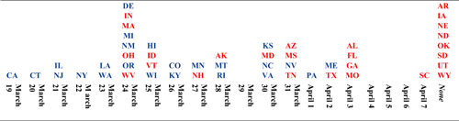
increasing uptake
Theory of elite cues → members of the public often follow cues from their party’s elites and ignore, or do the opposite of, cues from the other party’s elites.
Politization of COVID-19 → Since the earliest months of the pandemic, virtually all COVID-19-related attitudes, beliefs, and behaviors have been heavily polarized along party lines.

Slide 12
As partisans become more affective polarized (e.g., dislike for other party), they separate more on COVID-19 response.
Druckman et al. (NHB, 2021).

Slide 13
increasing uptake
Why? → Elite cues, which were very distinctive across parties, are particularly impactful among polarized partisans.
Theory of elite cues → attempts by Biden and other Democrats to encourage COVID-19 vaccination should have limited effects on Republicans’ vaccination intentions, or could even backfire, whereas messaging from Republican elites should be more successful.

Slide 14
Experiment
Dates → From March 17 to 24 2021.
Sample → 1,480 Republicans (from three providers: Mechanical Turk, CloudResearch, Bovitz).
23% had already received at least one dose of a COVID-19 vaccine.

Slide 15
Experiment
Randomly Assigned Conditions →
  Republicans endorse condition viewed a short video of former President Donald Trump endorsing vaccination and then read a short essay highlighting vaccine endorsements by prominent Republicans and hailing Republicans’ contributions to vaccine development and distribution
  Democrats endorse condition viewed a short video of President Joseph Biden encouraging vaccination and then read a parallel essay highlighting Democrats’ support for vaccination and role in development and distribution.
    This condition is captures the types of endorsements that many respondents were already exposed to at the time.
  The neutral control condition featured a short video and essay about an unrelated topic -- neckties -- ensuring participants had a similar experience in terms of receiving content.

Slide 16

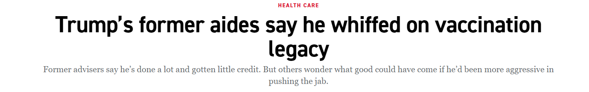
Experiment
“Former President Donald Trump’s unwillingness to pitch his voters on getting the jab has become the source of frustration for former aides, who lament the political benefits that would have come had he done so.”

Slide 17
Stimuli
Republicans endorse: https://youtu.be/apT0hxEPl78
Democrats endorse: https://youtu.be/e292n6Vv-sc

Slide 18
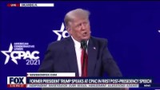
Trump Stimuli

Slide 19
Vaccine Intent

Slide 20
Possible Mediators

Slide 21
Vaccine Attitudes

Slide 22
Encouragement Intentions

Slide 23
Analyses
Estimates are based on linear models controlling for demographic characteristics (age, gender, race, education, and income) and, in the vaccination intention model, vaccination intentions reported pre-treatment.

Slide 24
Vaccine Intentions (Among unvaccinated)
Republicans endorse condition significantly increased vaccination intentions, when compared to the Democrats endorse condition → 7.0% higher for average respondent.
Republicans endorse condition significantly increased vaccination intentions, when compared to the neutral condition → 5.7% higher for average respondent.

Slide 25
Mediation
Republican Endorse → Trump/Reps. want them to get vaccine → Get Vaccine
This measure statistically mediated 28% of the effect (relative to Democrats endorse and 47% of the effect (relative to the neutral control condition).
The effect was not significantly mediated by the belief that Republican leaders deserve credit for the vaccination program, nor by respondents’ estimates of the percent of Republicans likely to be vaccinated by August 2021.

Slide 26
Vaccine Encouragement (Among All)
Republicans endorse significantly greater in encouragement relative to the Democrats endorse condition.
Mechanism is BACKFIRE → Democrats endorse leads to 10.2% less encouragement relative to the Republicans endorse and 12.2% less than the neutral condition.
Larger backfire among vaccinated respondents (unvaccinated already so low).

Slide 27
Vaccine Attitudes (Among All)
Republicans endorse significantly greater in attitudes relative to the Democrats endorse condition.
Mechanism is BACKFIRE → Democrats endorse lead to more negative attitudes.
Effect size was similar for both vaccinated and unvaccinated respondents.

Slide 28
Conclusions
Partisan divide over vaccine uptake has remained stable and is perhaps the main challenge.
Found endorsements of COVID-19 vaccines from Republican elites led to higher intentions to be vaccinated among self-identified Republicans. And elite Democrat endorsement reported more negative vaccine attitudes and were less likely to encourage others to vaccinate.

Slide 29
Conclusions
Resistance is not only driven by misinformation of low information but also a lack of awareness of Republican elite cues.
Novel evidence on cue effect mechanism.
Reveals the importance of partisan elites during health crises.
Reveals downside of one-sided partisan efforts.

Slide 30
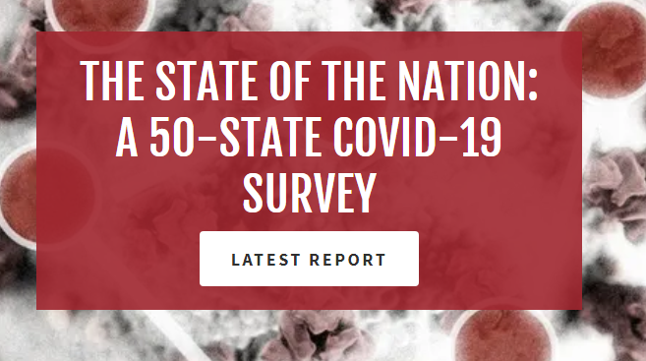
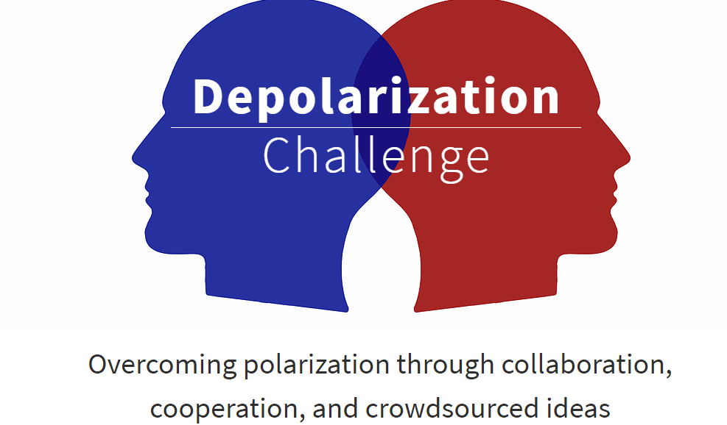
Ongoing projects

